Slide 1

OKI 2050 Metropolitan Transportation
Plan Update
Bob Koehler, Deputy Executive Director

Slide 2

Project Suggestions
Accepting ideas for projects to be considered for the 2050 Plan Update until 10/31/23. 🎃
Use the template (has examples) found here:
https://www.oki.org/submit-project-ideas-for-the-2050- transportation-plan-update/

Slide 3
OKI Region Demographic for Metropolitan Transportation Plan – Michael Outrich, OKI Staff
Background
Population, Household, Employment & Commuting Trends influence Long-Range Transportation Planning Efforts
Historical trends influence future projections

Slide 4
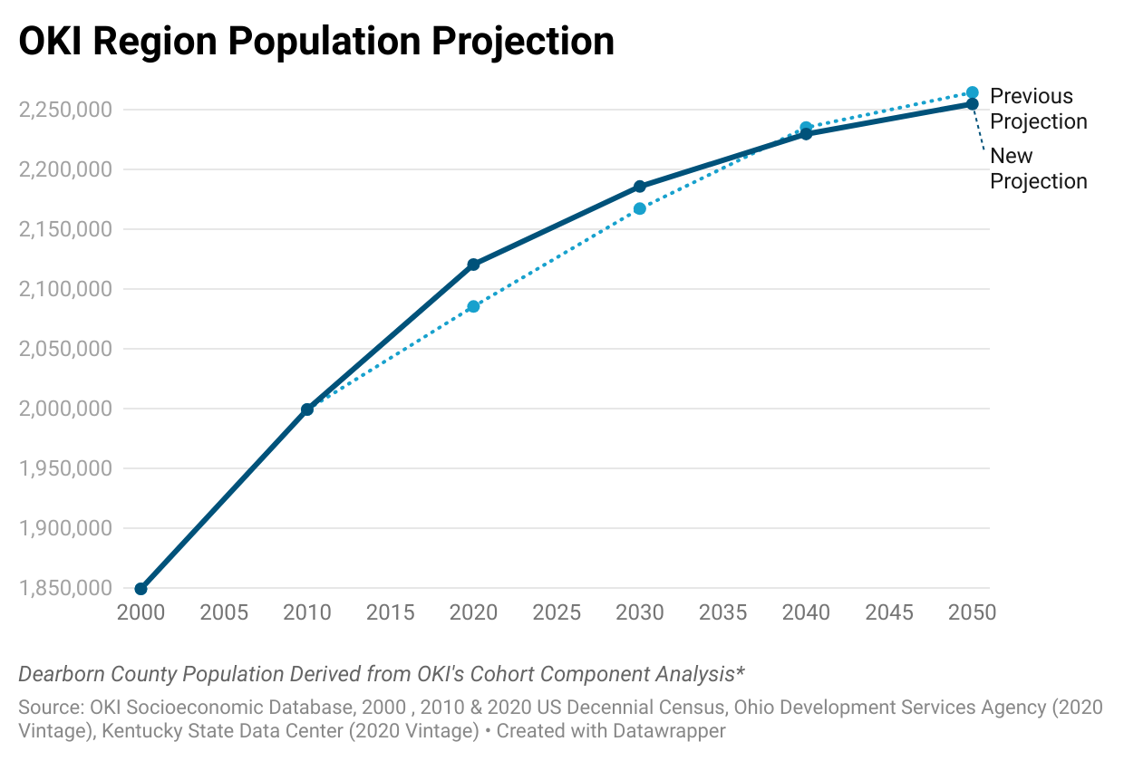
Population Trends
Year | Old Projection | New Projection | Difference
2000 | 1,849,602 | 1,849,602 | 0
2010 | 1,999,482 | 1,999,482 | 0
2020 | 2,085,588 | 2,120,720 | 35,132
2030 | 2,167,356 | 2,185,886 | 18,530
2040 | 2,235,275 | 2,229,766 | -5,509
2050 | 2,264,538 | 2,254,878 | -9,660
Gain of 134,157 persons between 2020 and 2050 (6.3% Increase)
HUD SOCDS Building Permit Database
https://socds.huduser.gov/permits/
US Census Bureau, 2000, 2010, and 2020 PL 94-171 Redistricting Data, Total Population

Slide 5
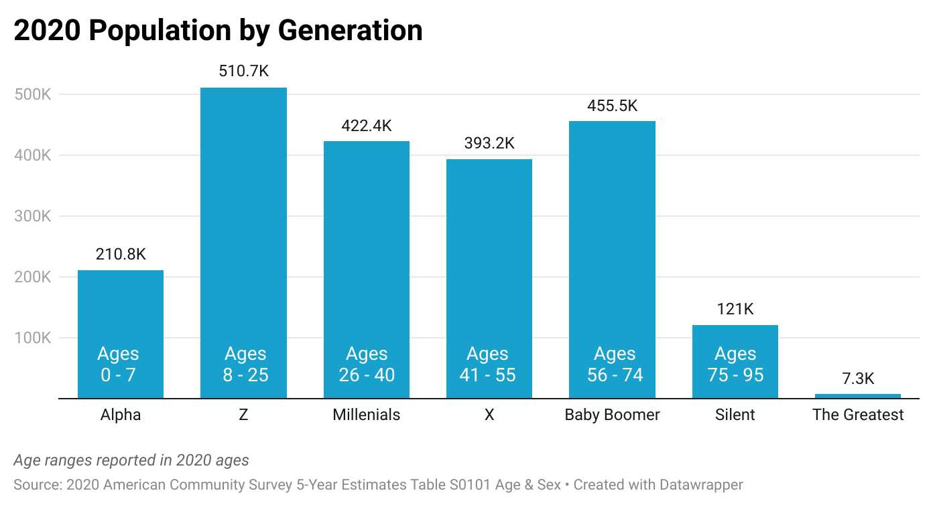
OKI Population by Generation
  Generation Z is largest
  Colleges & Universities influence figures
 | Youngest Year | Oldest Year
The Greatest | 1924
Silent | 1945 | 1925
Baby Boomer | 1964 | 1946
X | 1979 | 1965
Millenials | 1994 | 1980
Z | 2012 | 1995
Alpha | 2020 | 2013
Center for Generational Kinetics
https://genhq.com/the-generations-hub/generational-faqs/
Notes:
The Greatest: 1924 to 1900
Silent: 1945 to 1925
Baby Boomer: 1964 to 1946
X: 1979 to 1965
Millennials: 1994 to 1980
Z: 2012 to 1995
Alpha: 2020 to 2013

Slide 6
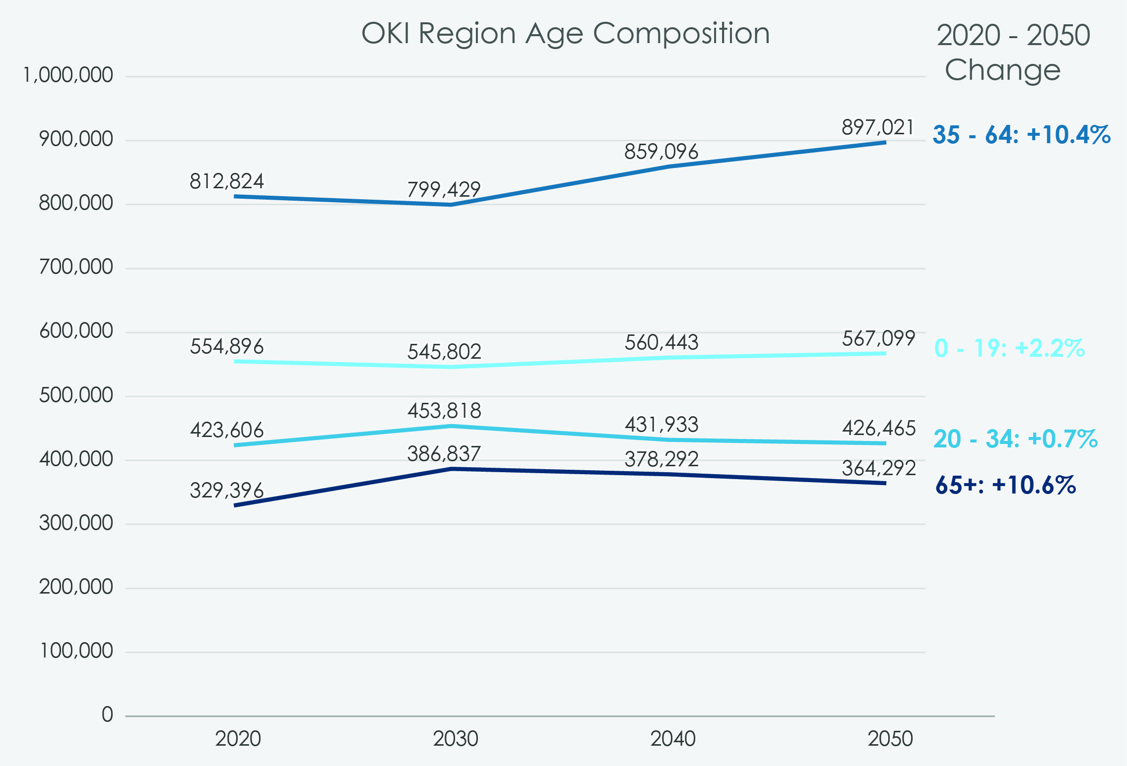
OKI Region Age Cohort Projection
  Largest Gains in Seniors and Working Age Adults
  2030 Minimum for those 19 & Under
  2030 Maximum for those 65 & Older
+84,198
+10.4%

Slide 7
OKI Region Projected Households
  Gain of 88,613 Households
    10.8% Increase
  Number of Households grows, while overall size decline
    Decline in Household size projected to stabilize
 | 2020 | 2030 | 2040 | 2050
Average Household Size | 2.54 | 2.44 | 2.43 | 2.43

Slide 8
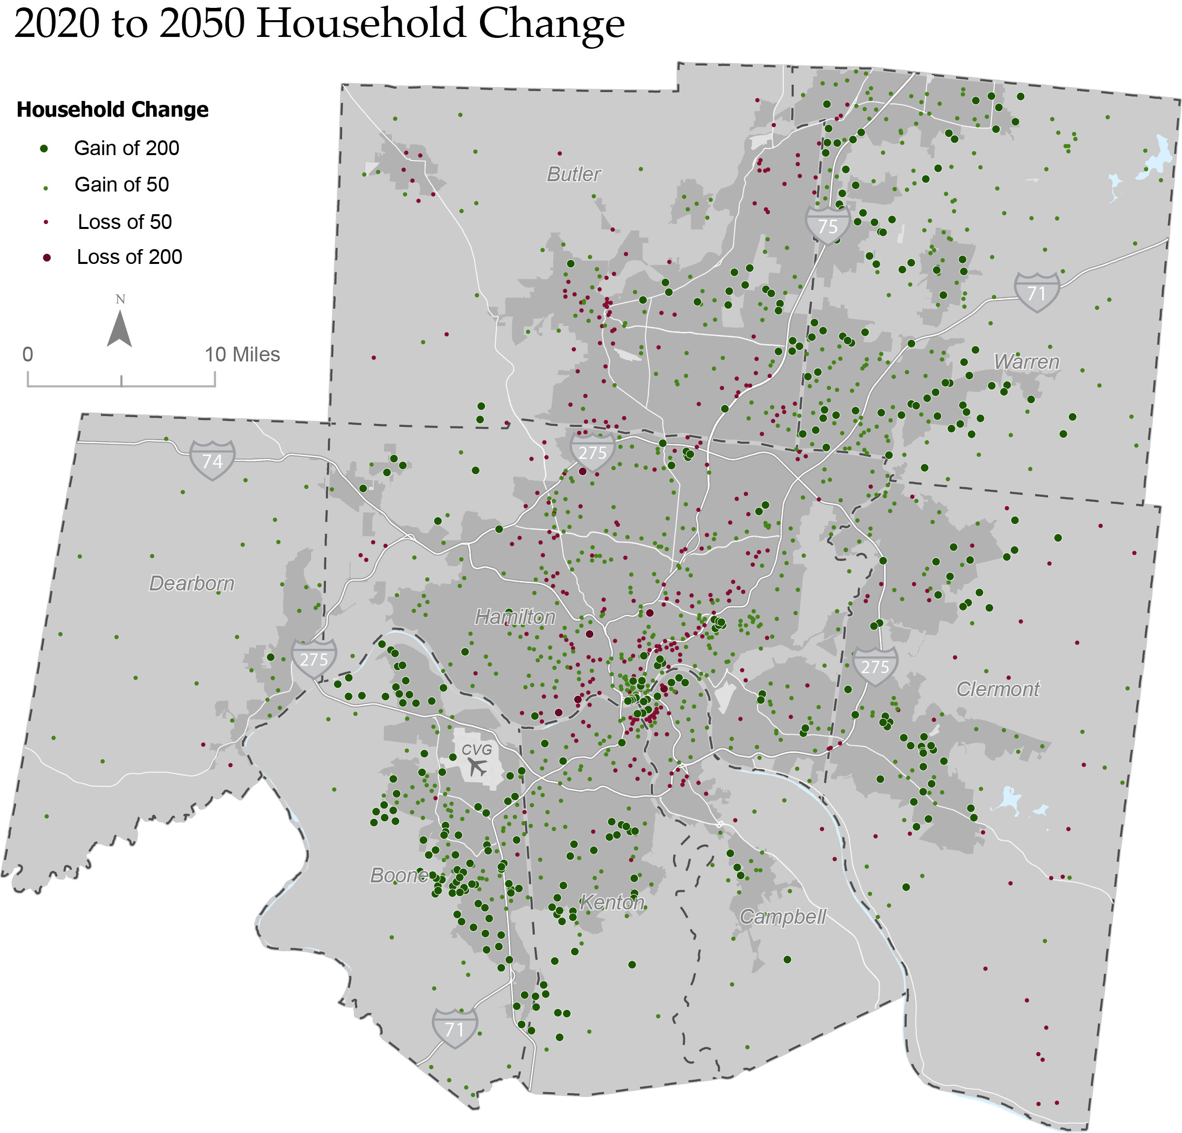
OKI Region
Projected Household Change
Butler
  Expected household growth in:
    Greenfield communities
    Dense infill on greyfield / brownfield sites in hot residential real estate markets
    Urban core & nearby riverfront communities
Warren
Dearborn
Hamilton
Clermont
  Expected household loss in:
    Aging built out suburban areas
    Distressed urban neighborhoods
    Rural Appalachian communities
Boone
Kenton
Campbell
US Census Bureau, 2010 and 2020 PL 94-171 Redistricting Data, Total Population

Slide 9
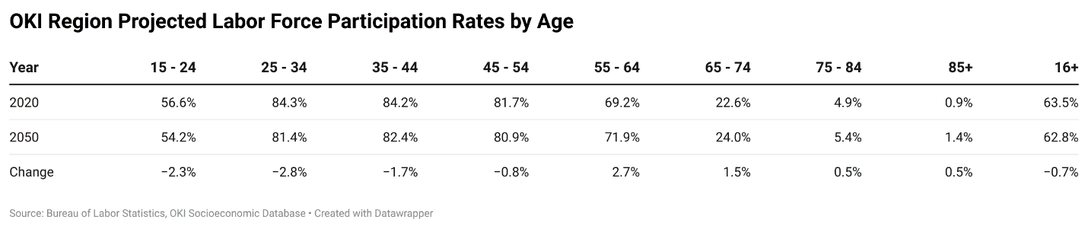
OKI Projected Labor Force Participation Rates
  Workers approaching retirement age and those over 65 are projected to be more likely to work
  Workers in the 25 to 45 age range are projected slight declines due to the rising cost of childcare and furthering education through post-secondary options
  Workers in the 15 to 24 age range are projected to see slight declines due to a projected return to a more balanced labor market and more in post-secondary education
https://www.bls.gov/news.release/pdf/ecopro.pdf
Notes:
The labor force participation rate of women peaked at 60.0 percent in 1999, after several decades of strong growth. However, the rate has been decreasing in the past 15 years. BLS projects the decline to continue.
• The labor force participation of men has been declining steadily since the end of the 1940s. This long-term declining trend is projected to continue throughout the next decade.
• The labor force participation rate of youths—the group of 16-to-24-year-olds—has declined considerably over the past several decades, especially since 2000. The reason is that more young people than ever are enrolling in school in order to become more competitive in the labor market. The declining trend is expected to continue in the next decade.¹¹
• The prime-age group—the 25-to-54-year-olds—has the strongest attachment to the labor market. However, even its labor force participation rate declined during 2004–2014, by nearly 2 percentage points. The rate is estimated to increase slightly over the projection period.
• The baby boomers make up a large share of both the population and the labor force, with a big impact on the labor force participation rate. As the baby boomers have aged and moved from the prime-age group, with the highest participation rates, to the 55-years-and-older group, with participation rates far lower than that, the overall labor force participation rate has declined and will continue to do so over the next decade.

Slide 10
OKI Projected Job Sector Changes
Change in Jobs between 2020 to 2050
1,081,099
1,093,282
1,114,714
All Jobs: +62,247 (5.9%)
1,052,467
Educational Services: +38,155 (47.5%)
Accommodation & Food Services: +23,041 (23.3%)
Retail Trade: -18,077 (-17.4%)
Manufacturing: -24,433 (-20.8%)
Health Care & Social Assistance: +38,961 (24.2%)
Other Jobs: +4,600 (0.9%)
Woods & Poole 2023

Slide 11
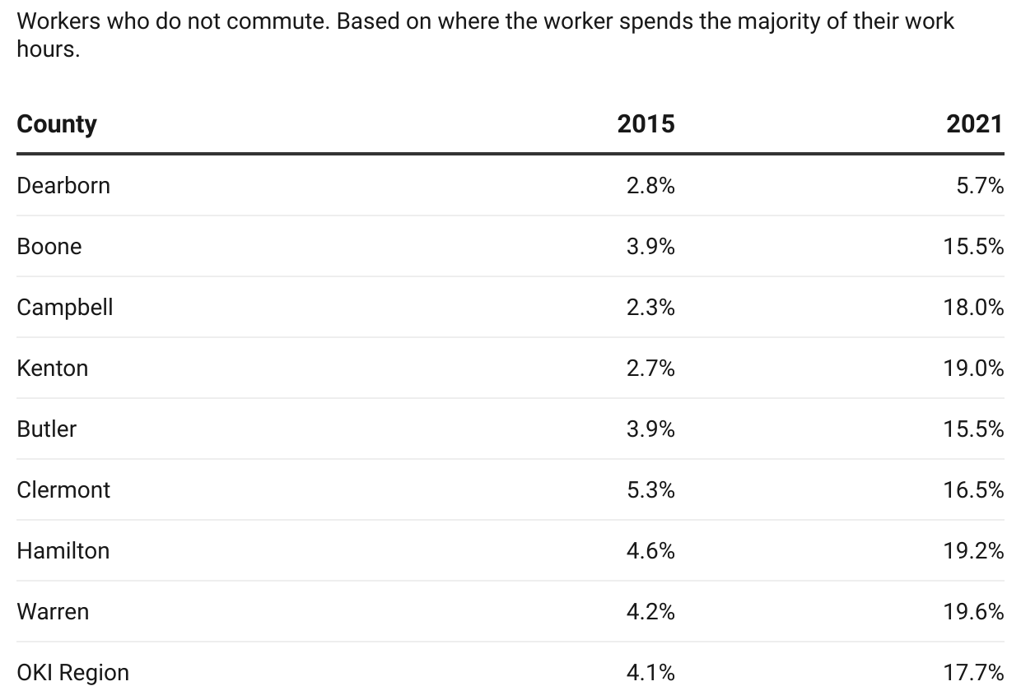
Work From Home
  Significant increase in telecommuting from the COVID19 Pandemic
  Regional rate likely to settle around 8 -12% as more workers return to the office
Dearborn County data from ACS 5 Year Estimates which artificially reduce telecommuting rate
2015 & 2021 American Community Survey 1-Year estimates Table S0801 Commuting Characteristics by Sex. Dearborn County Uses 5-Year estimates only

Slide 12
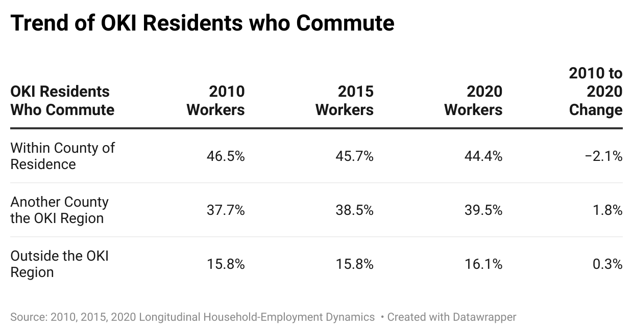
Commuting Destinations
  Commuters more likely to travel out of county for work
  Slightly more likely to travel out of region
    Driven by Dearborn, Warren, and Butler counties
  Campbell County has the most residents that work in other counties
    21% in 2010, 31% in 2020
  Hamilton County has the least intercounty commuters
    69% in 2010, 66% in 2020
2015 & 2021 American Community Survey 1-Year estimates Table S0801 Commuting Characteristics by Sex. Dearborn County Uses 5-Year estimates only

Slide 13
Commuting Mode
Change in mode between 2015 to 2021
1,030,025
All Modes: +47,416 (4.8%)
982,609
Work From Home: +141,507 (348.9%)
Taxi, Motorcycle, or Other:
2015: 8,143 (0.8%)
2021: 11,801 (1.1%)
+3,658 (44.9%)
Bicycle or Walked:
2015: 22,192 (2.3%)
2021: 20,043 (1.9%)
-2,149 (-9.7%)
Public Transportation:
2015: 20,743 (2.1%)
2021: 10,100 (1.0%)
-10,643 (-51.3%)
Carpooled: -12,687 (-16.5%)
Drove alone: -72,549 (-8.9%)
2015 & 2021 American Community Survey 1-Year estimates Table S0801 Commuting Characteristics by Sex. Dearborn County Uses 5-Year estimates only

Slide 14
Summary
Region continues to gain population and jobs but at a slowing rate
  In 2030 the share of seniors are projected to peak, those 19 & Under are projected be a minimum
Labor Force is aging
  Those of retirement age are working longer
  Post-secondary education and cost of childcare lower labor force participation rates
Commuters are traveling out of home county and region in greater numbers for work
Rise in telecommuting are expected to continue to affect commuting patterns

Slide 15
Questions?
Contact:
Michael Outrich, Senior Planner/Demographer
513-619-7678
moutrich@oki.org

