Slide 1

OKI Region Population Projection Update
ICC Meeting
May 9th 2023

Slide 2

Background
Updated population projections inform:
The OKI 2050 Transportation Plan
OKI’s Travel Demand Model

Slide 3
OKI Region Population Growth Facilitators
Increases in building activity
Historical Population Growth
 | Total Population | Change In Population
2000 | 1,884,784
2010 | 1,999,486 | 114,702
2020 | 2,120,427 | 120,941
Growing share of multifamily permits
13% in 2010
38% in 2021
HUD SOCDS Building Permit Database
https://socds.huduser.gov/permits/
US Census Bureau, 2000, 2010, and 2020 PL 94-171 Redistricting Data, Total Population

Slide 4
OKI Region Population Growth Facilitators
Persistent Job Growth
Change In Jobs
Gain of
127,958
4,218
9,022
23,236
19,984
17,194
22,184
15,822
12,111
14,492
13,406
-49,842
26,131
U.S. Census Bureau, Center for Economic Studies, LEHD
8 County Region Beginning of Quarter Employment Counts Q1 2010 through Q1 2022
Notes:
Business locations are tied to the locations of the firms on the Unemployment Insurance forms. Covers 97% of all employment

Slide 5
OKI Region Population Growth Facilitators
Steady inflow from outside the Region
SOI Tax Stats – Migration Data, OKI 8 Counties Years 2015 – 2020
https://www.irs.gov/statistics/soi-tax-stats-migration-data
Notes:
Migration data for the United States are based on year-to-year address changes reported on individual income tax returns filed with the IRS.

Slide 6
OKI Region Population Growth Hinderers
Aging Workforce
Age | 2010 | 2022 | Percent Change
14-18 | 20,235 | 34,625 | 71%
19-21 | 43,679 | 51,453 | 18%
22-24 | 54,255 | 61,457 | 13%
25-34 | 196,909 | 223,344 | 13%
35-44 | 201,077 | 222,238 | 11%
45-54 | 220,262 | 201,304 | -9%
55-64 | 133,341 | 174,333 | 31%
65-99 | 34,362 | 63,324 | 84%
All | 904,120 | 1,032,078 | 14%
U.S. Census Bureau, Center for Economic Studies, LEHD
OKI 8 Counties Beginning of Quarter Employment Counts by Age Q1 2010 through Q1 2022

Slide 7
OKI Region Population Growth Hinderers
Decrease in Births / Fertility Rates
Less Children
32,660
-12,131
77,570
Annual number of births decreased by 1,380
If the 2014 fertility rate of 65.05 held constant, 5,146 more live births would have occurred
Declining Regional share of those under 18
25.2% of Regional Population in 2010
23.4% of Regional Population in 2020
Share of 65 and older is growing fastest
12.0% of Regional Population in 2010
15.1% of Regional Population in 2020
CDC Wonder OKI Counties Natality 2014 – 2021
https://wonder.cdc.gov/controller/datarequest/D66
OKI Region Population by Age
2010 and 2020 ACS 5 Year Estimates

Slide 8
OKI Region Population Growth Hinderers
Increase in Crude Death Rate
Rate of Natural Increase Slowing
Number of deaths increased by 4,552
COVID 19 deaths resulted in an increase
2022 National trends show a declining death rate, but still higher than 2019
Natural Increase decreased by 74%
Growth becoming more reliant on migration
21% of Growth in 2014
63% of Growth in 2021
US Census Vintage Population Estimates Components of Change

Slide 9
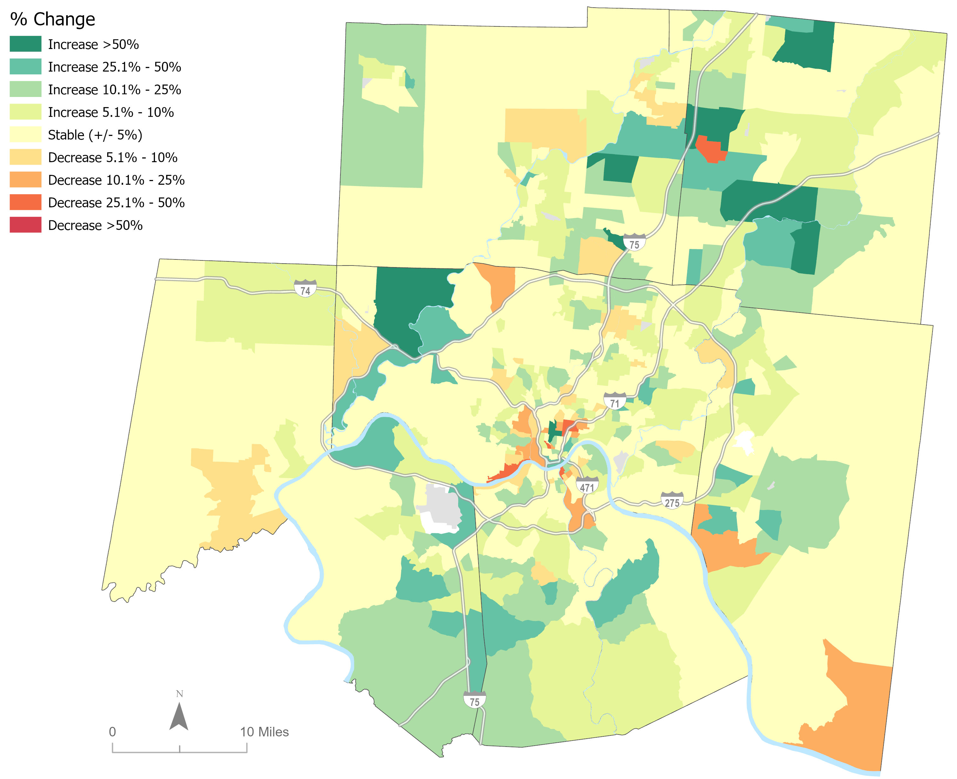
OKI Region Percent Population Change 2010 - 2020
Butler
Warren
Hamilton
Dearborn
Clermont
Boone
Campbell
Kenton
US Census Bureau, 2010 and 2020 PL 94-171 Redistricting Data, Total Population

Slide 10
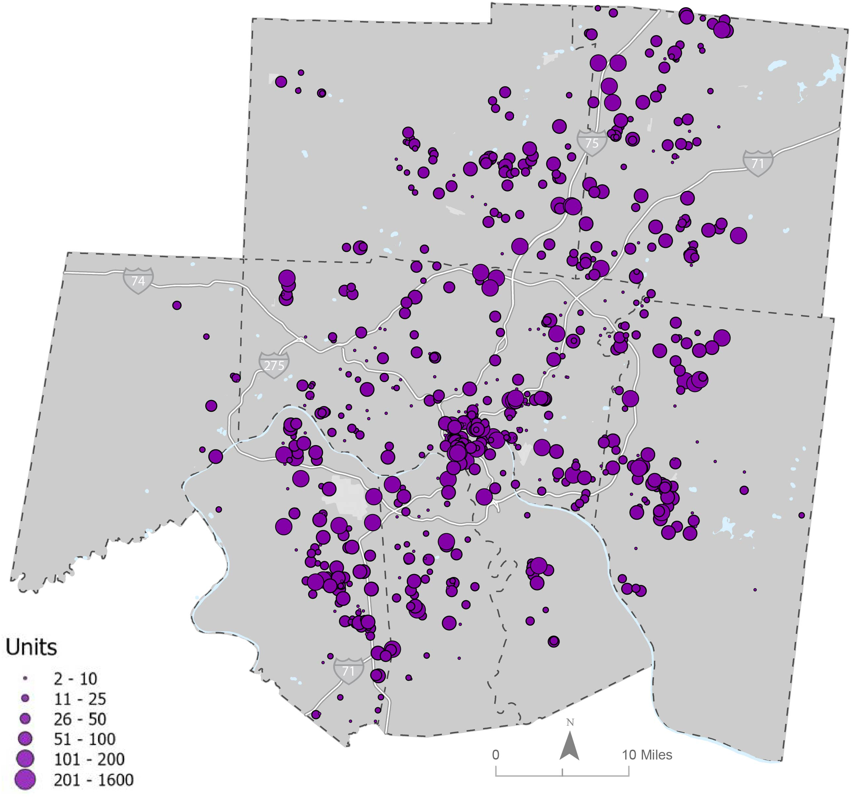
OKI Region Ongoing Residential Developments
Butler
Warren
Includes all residential units proposed and constructed since 2020
Hamilton
Dearborn
Clermont
Projected Population Change 2020 to 2030 & Residential Development Since 2020 (oki.org)
Boone
Campbell
Kenton
Various County and Local Governments

Slide 11
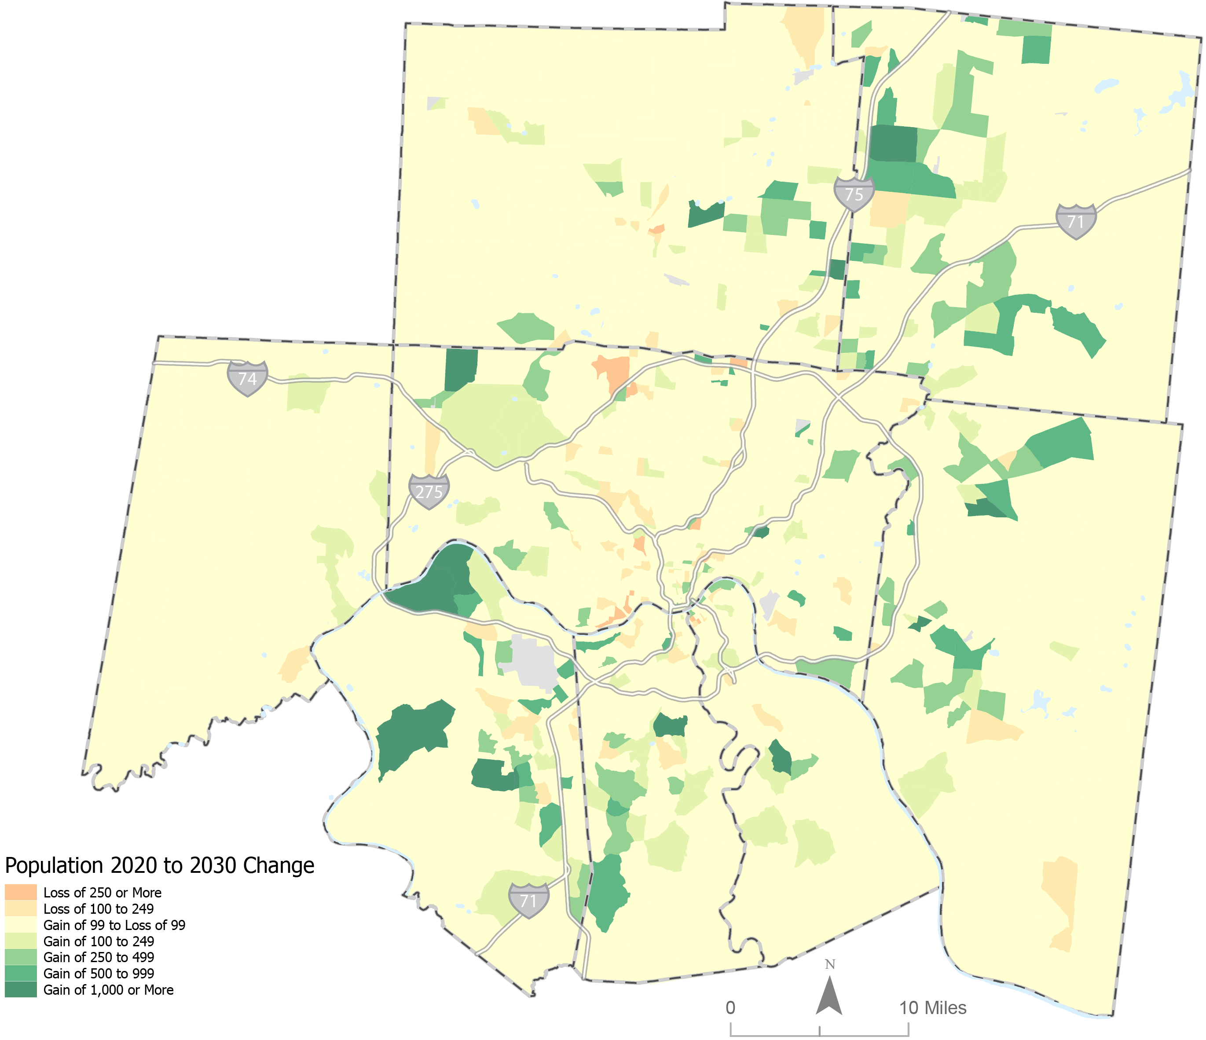
OKI Region Projected Change 2020 to 2030
Butler
Warren
Gaining Population
Union (Ballyshannon)
Covington (Tuscany)
North Hebron (Northpointe)
B
Hamilton
Dearborn
C
A
Clermont
3
Losing Population
2
Avondale
Colerain Township
Millvale / South Cumminsville
1
Boone
Campbell
Kenton
US Census Bureau, 2020 PL 94-171 Redistricting Data, State Data Center

Slide 12
Summary
Region continues to gain population and jobs
2020 Population gains exceeded previous projection (33,000)
Peak Employment was in January 2020, Pandemic stunted growth
Growth in housing permits
Strongest growth in multifamily units
Region’s workforce and population continues to age
Declining birth rate, less children, elevated mortality

Slide 13
Request for Assistance
Guidance from County and Local Governments on:
Feedback on projections and areas of growth and decline
New Construction on Industrial, Commercial, or Office locations that will have >100 jobs at each site

Slide 14
Questions?
Contact:
Michael Outrich, Senior Planner/Demographer
513-619-7678
moutrich@oki.org

