Slide 1
HAM-Plainfield rd roundabouts
How Funding Fixed Congestion and Safety Issues in Blue Ash
PRESENTED BY:
CRAIG LITMER, PE
Notes:
American Structurepoint is a multi-disciplined design consultant that worked extensively with the City of Blue Ash to deliver this project.

Slide 2
Introduction

Slide 3
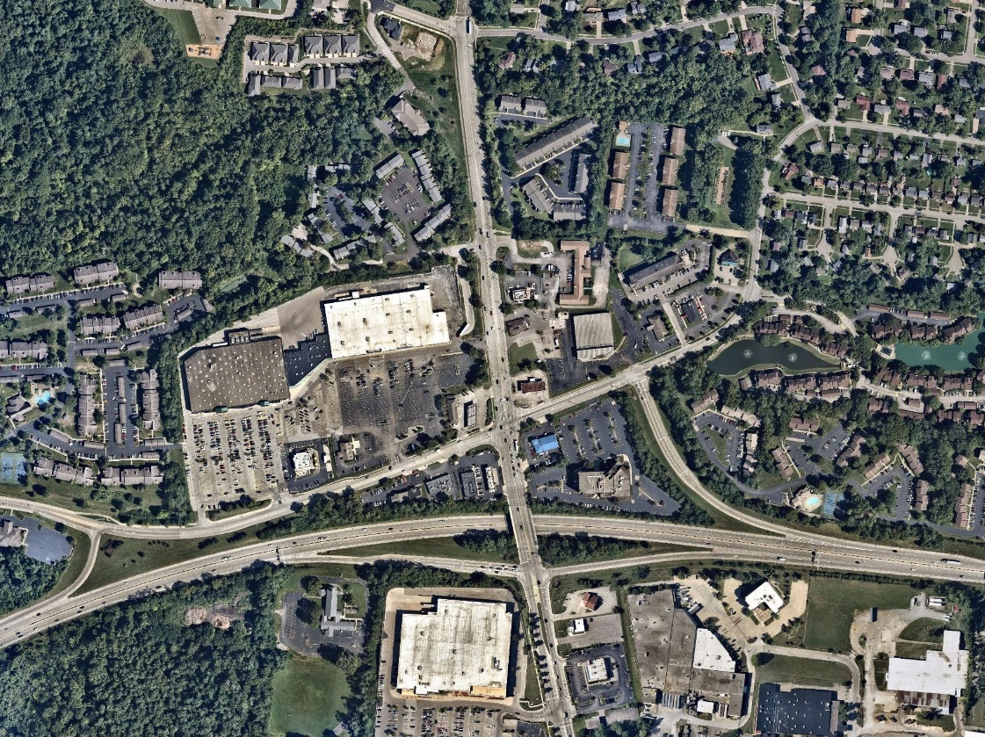
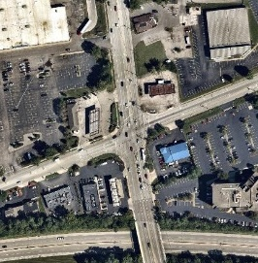
PROJECT LOCATION
Peppermill rd
Plainfield rd
Hunt rd
Wb entry ramp
Wb exit ramp
Eb entry ramp
Eb exit ramp
Sr 126 (Ronald Reagan hwy)
Notes:
Blue Ash is a northeast suburb in Cincinnati.
Hunt Rd and Plainfield Rd intersection that was the keystone of this project is located between the SR-126 split ramp interchange. This unique layout has the westbound exit and entry ramps about ½ mile apart.
The Plainfield corridor carries 30,000 veh per day. With a population of 12,000, this truly is a commuter corridor, heavy peak hour traffic distributions in the AM and PM.

Slide 4
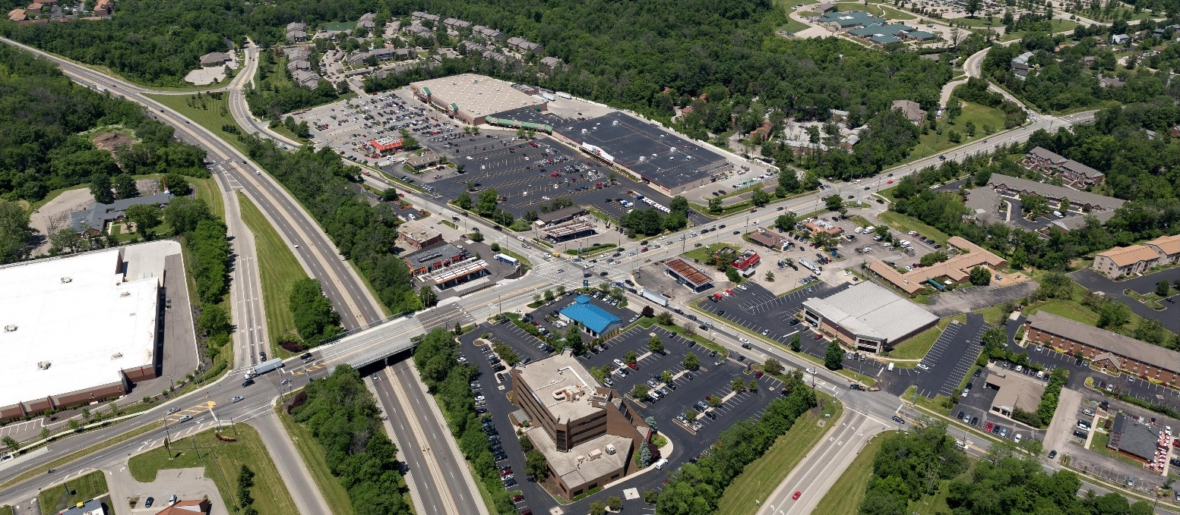
Existing corridor features
Chabad jewish center
uc blue ash
Blue ash elementary school
kroger
Sr-126 (Ronald Reagan hwy)
Big lots
Metro stop
mcdonalds
Kohl’s
Peppermill ln
Taco bell
speedway
St Andrews pl
shell
Skyline chili
marathon
Evan’s auto
Crossgate lanes
target
Plainfield rd
Hunt rd
Notes:
There are a wide variety of users in this corridor.
Pedestrians—orthodox Jewish community walking to the synagogue that can’t touch ped push buttons
children crossing peppermill to go to school.
Vehicles - Commuters to work, Students driving to UC Blue Ash rushing for the 8am class,
tanker trucks swinging through the intersection to access the gas stations,
WB-67 interstate semi trucks going to restock Kroger,
school and metro buses,
an intersection over capacity,
unmanaged driveways on Hunt Road.

Slide 5
Existing corridor
#12 most dangerous intersection in Ohio
263 accidents in 3-year period
25 mph legal speed
Severe accidents
Injuries and fatalities
Commercial vacancies
Crime
2nd largest economy in metropolitan area
Notes:
All of these ingredients came together to produce the #12 most dangerous intersection in Ohio by crash rate. Not just Cincinnati, All of Ohio.
Even though Blue Ash has one of the lowest vacancy rates in the area, there were business vacancies in prominent locations in the corridor. Old Arby’s parcel and Marathon properties and the old K-mart building took years to redevelop into Kohl’s and Big Lots.
The vacant Marathon station parking lot was a hot bed for criminal activity.
With all of these components, it was a corridor you held your breath and tried to make it thru.
But this is the heart of Blue Ash.

Slide 6
The Study phase

Slide 7
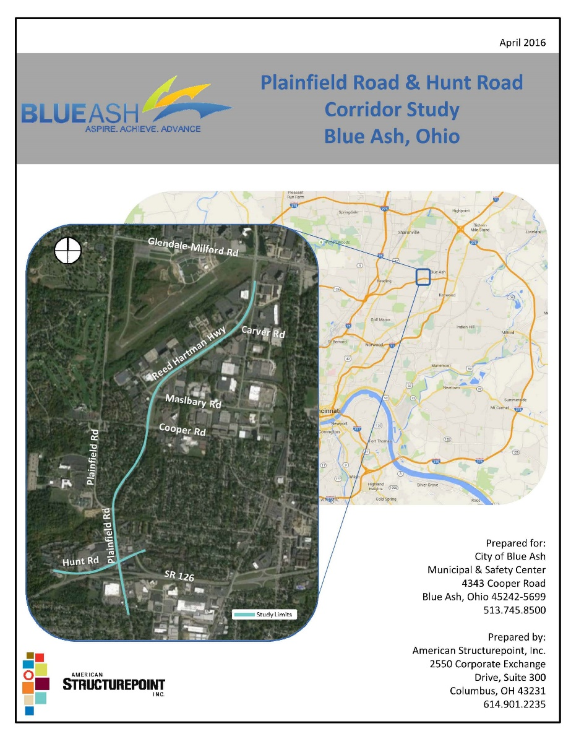
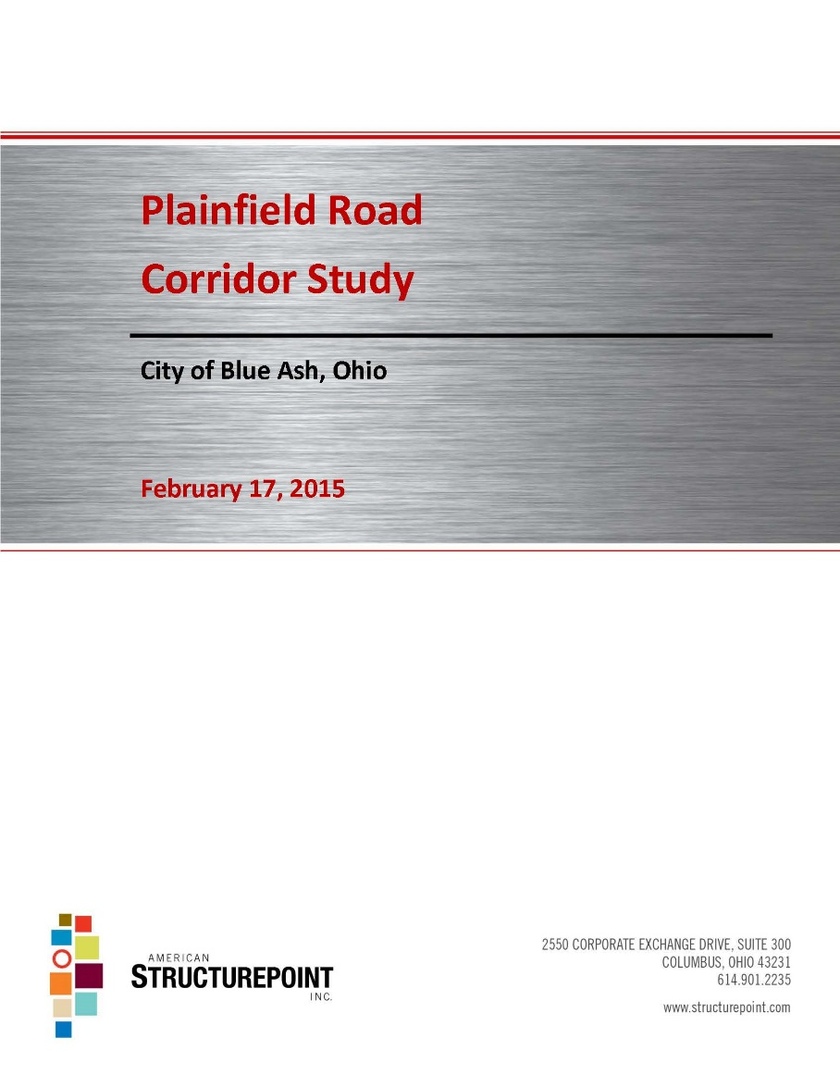
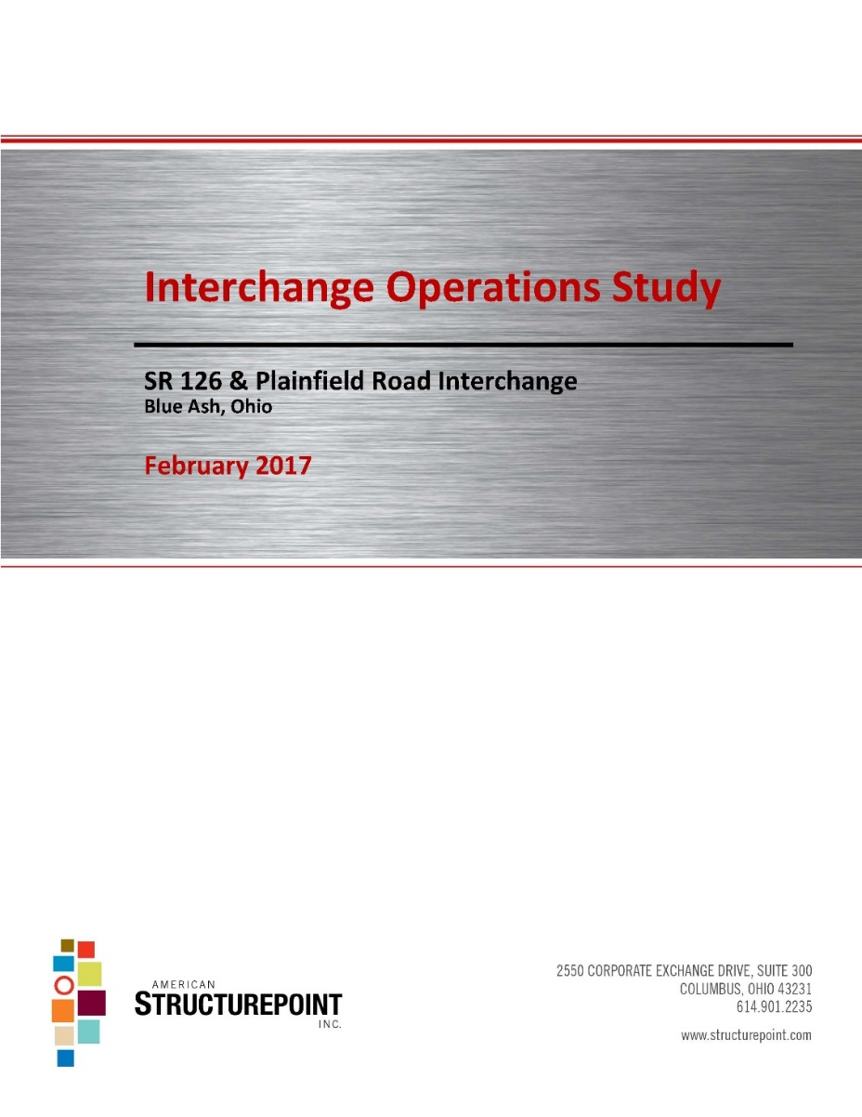
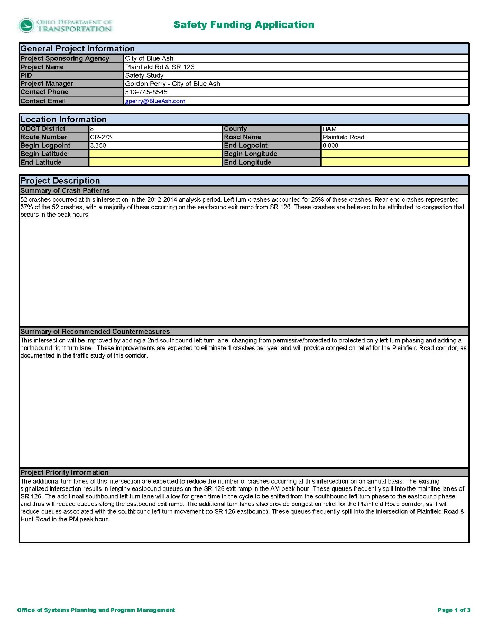
Study phase
Engaged the public
Safety audit
Safety study
Traffic Modeling
Developed proposed countermeasures
3D rendering of multi-lane roundabout corridor
Engaged the public
Notes:
Met with stakeholders from local businesses, property owners, EMS, Sycamore school District, University of Cincinnati to see what improvements would directly benefit their facilities. With the variety of stakeholders in the area, public outreach would be critical.
Performed the safety study and audit. Modeled the existing traffic.
Analysis of short term and long term theoretical solutions. Lane widening, signal improvements and roundabouts.
We looked at other places around the country to see what outside the box solutions communities have come up with that have measured results.
With this information, we developed our concept a 3-roundabout system, 2 of them being of the multi-lane variety with access management along the entirety of Hunt Rd. Reducing rush hour queue lengths reduced by 95%, and $7M less expensive than traditional improvements.
Engage the public. Its on their twice and its not an accident. Single lane roundabouts have their skeptics, but multi-lane roundabouts have more outspoken detractors. And there were businesses that felt that access management would block their entrances. So this outreach, listening to their concerns and providing information, knowing that some of the perception of the success of the project is public opinion.

Slide 8
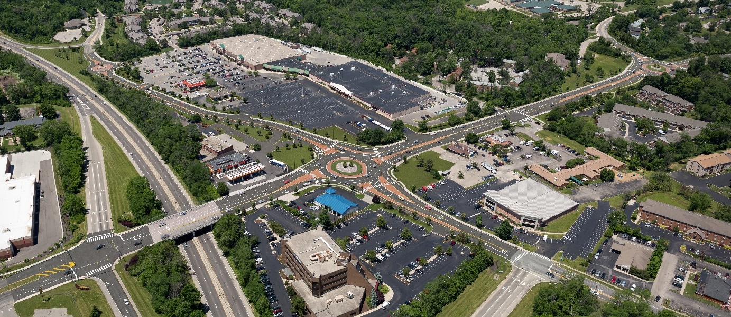
Proposed rendering
Peppermill ln
Plainfield rd
Hunt rd
Notes:
Proposed rendering, a multi-lane roundabout. 3 roundabout system in the corridor, 2 of them multi lane with the largest at Hunt/Plainfield intersection.
Improved safety to both motorists and pedestrians
New sidewalks
Shorter pedestrian crossings
Improved street lighting
Reduced vehicular speeds
Reduced conflict points for both pedestrians and motorists
Access management along Hunt Rd to reduce left turning conflicts from driveways

Slide 9
Project funding

Slide 10
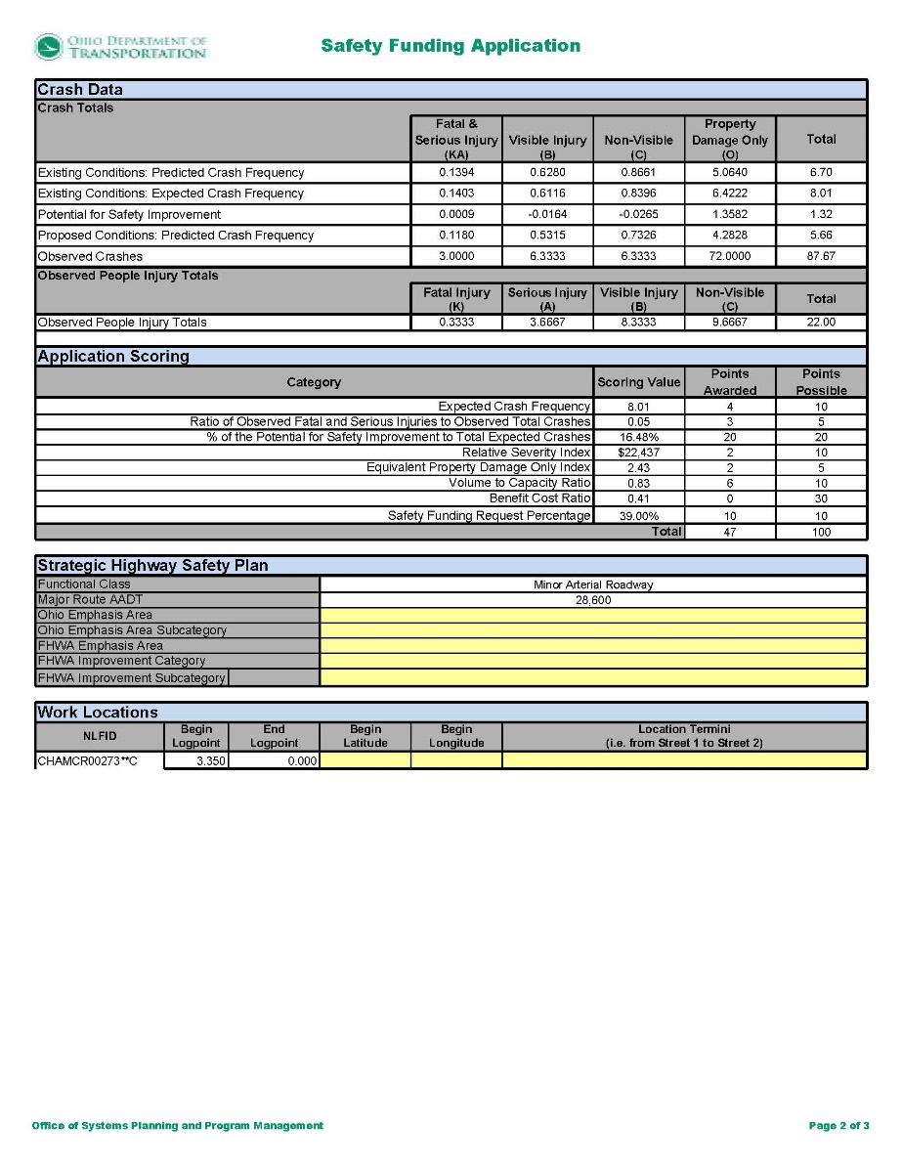
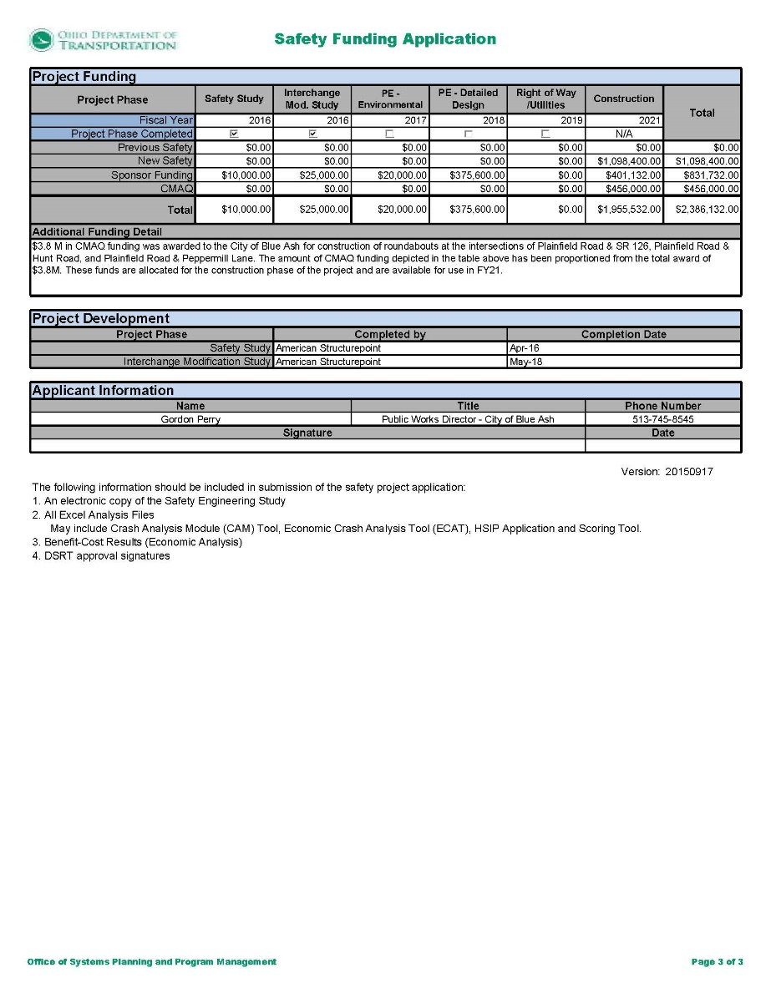
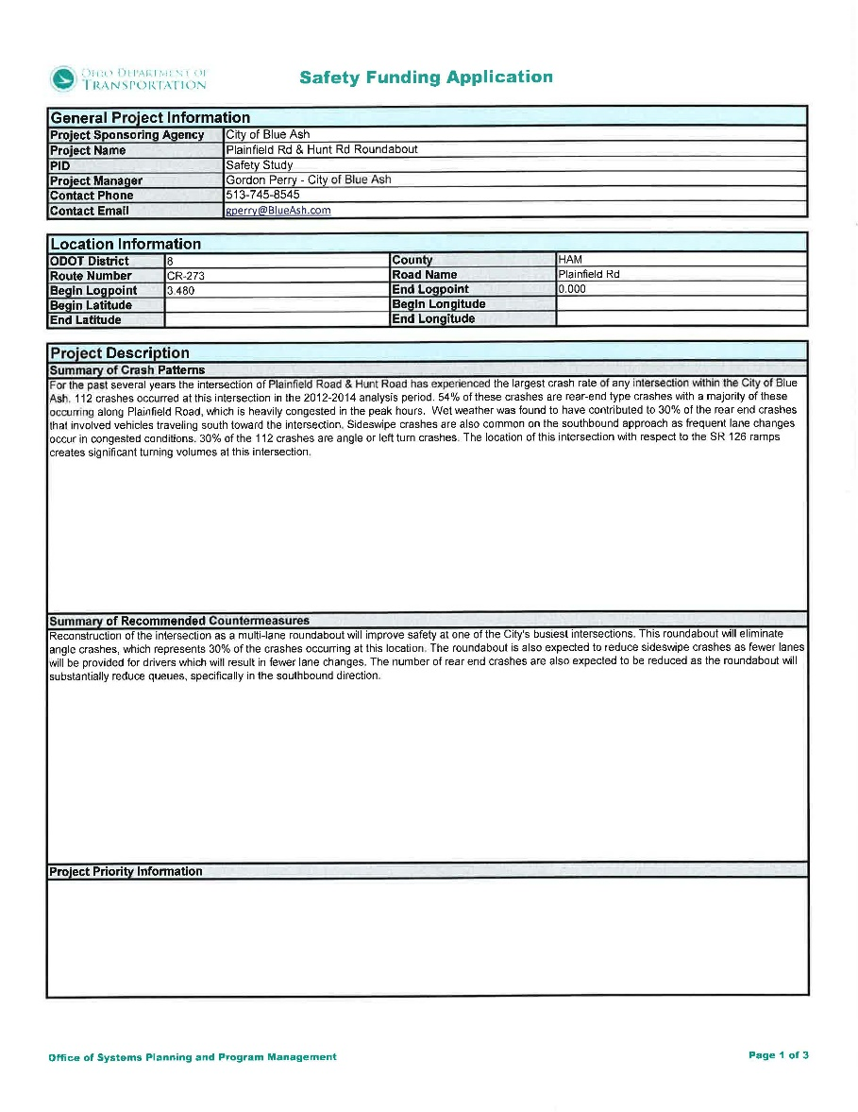
Project funding
HSIP – Highway Safety Improvement Program
CMAQ – Congestion Mitigation and Air Quality Improvement
STP – Surface Transportation Program
Notes:
We had studied the corridor extensively and really believed in our solution.
The City of Blue Ash believed in the project. Public Works Director Gordon Perry was a staunch supporter and driver of the project.
But we needed some financial assistance to bring this to life.
We found a great partner in OKI to help us navigate the funding process and identify categories that we would show strongly.

Slide 11
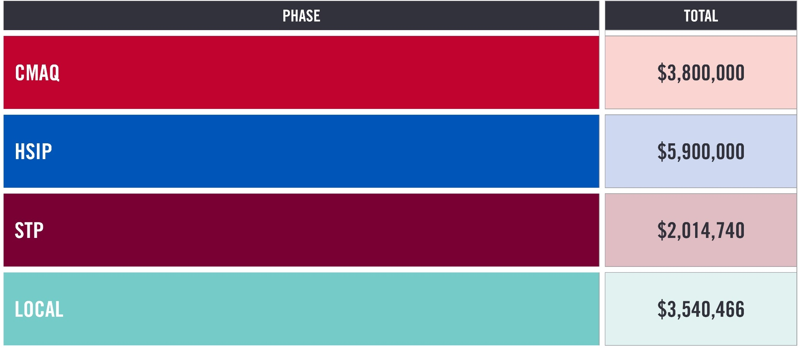
Project funding
$15 MILLION
TOTAL PROJECT COST
SECURED $11 MILLION OF
FUNDING THROUGH GRANTS

Slide 12
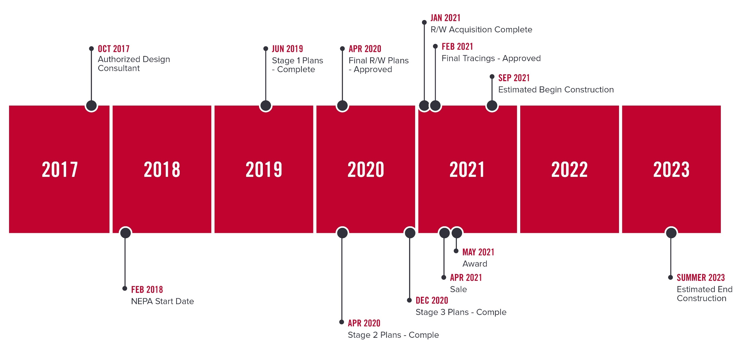
Schedule
Notes:
So, we set a schedule.
The bulk of the detailed design would take place between 2018 and 2020
Construction would kick off in late 2021 and wrap up in early 2023.

Slide 13
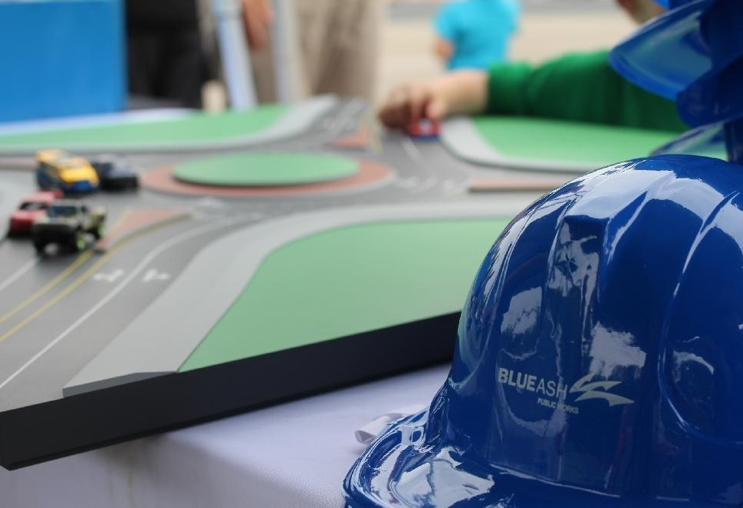
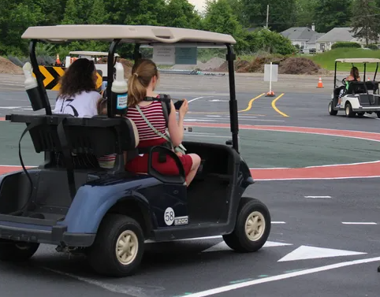
Engage the public!
Photo courtesy of: https://www.blueash.com/news_detail_T2_R503.php
Photo courtesy of: https://www.cincinnati.com/story/news/2019/05/23/having-problems-roundabouts-blue-ash-can-help/1206216001/
Notes:
Once the project was funded and the schedule was set, Blue Ash went back to public engagement with education initiatives.
Blue Ash had a multi-lane roundabout painted in the parking lot at Summit park at a scale appropriate for Golf Carts. During events, the public could experience the from a real world driver’s point of view.
We even had a multi-lane roundabout 3-D printed appropriate for match box cars to further teach the rules of the road.

Slide 14
construction

Slide 15
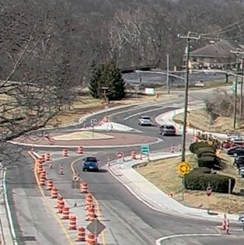
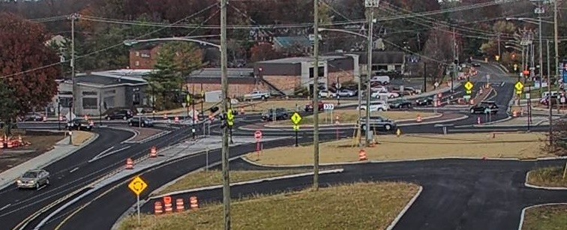
construction
Hunt rd / Kroger roundabout
Open march 2022
Peppermill ln / Plainfield rd roundabout
Expected open spring 2023
Hunt rd / Plainfield rd roundabout
Open october 2022
Plainfield rd
Peppermill ln
Hunt rd
Notes:
The photos are from a panoramic construction camera the City had installed on Hunt Road to oversee the project.

Slide 16
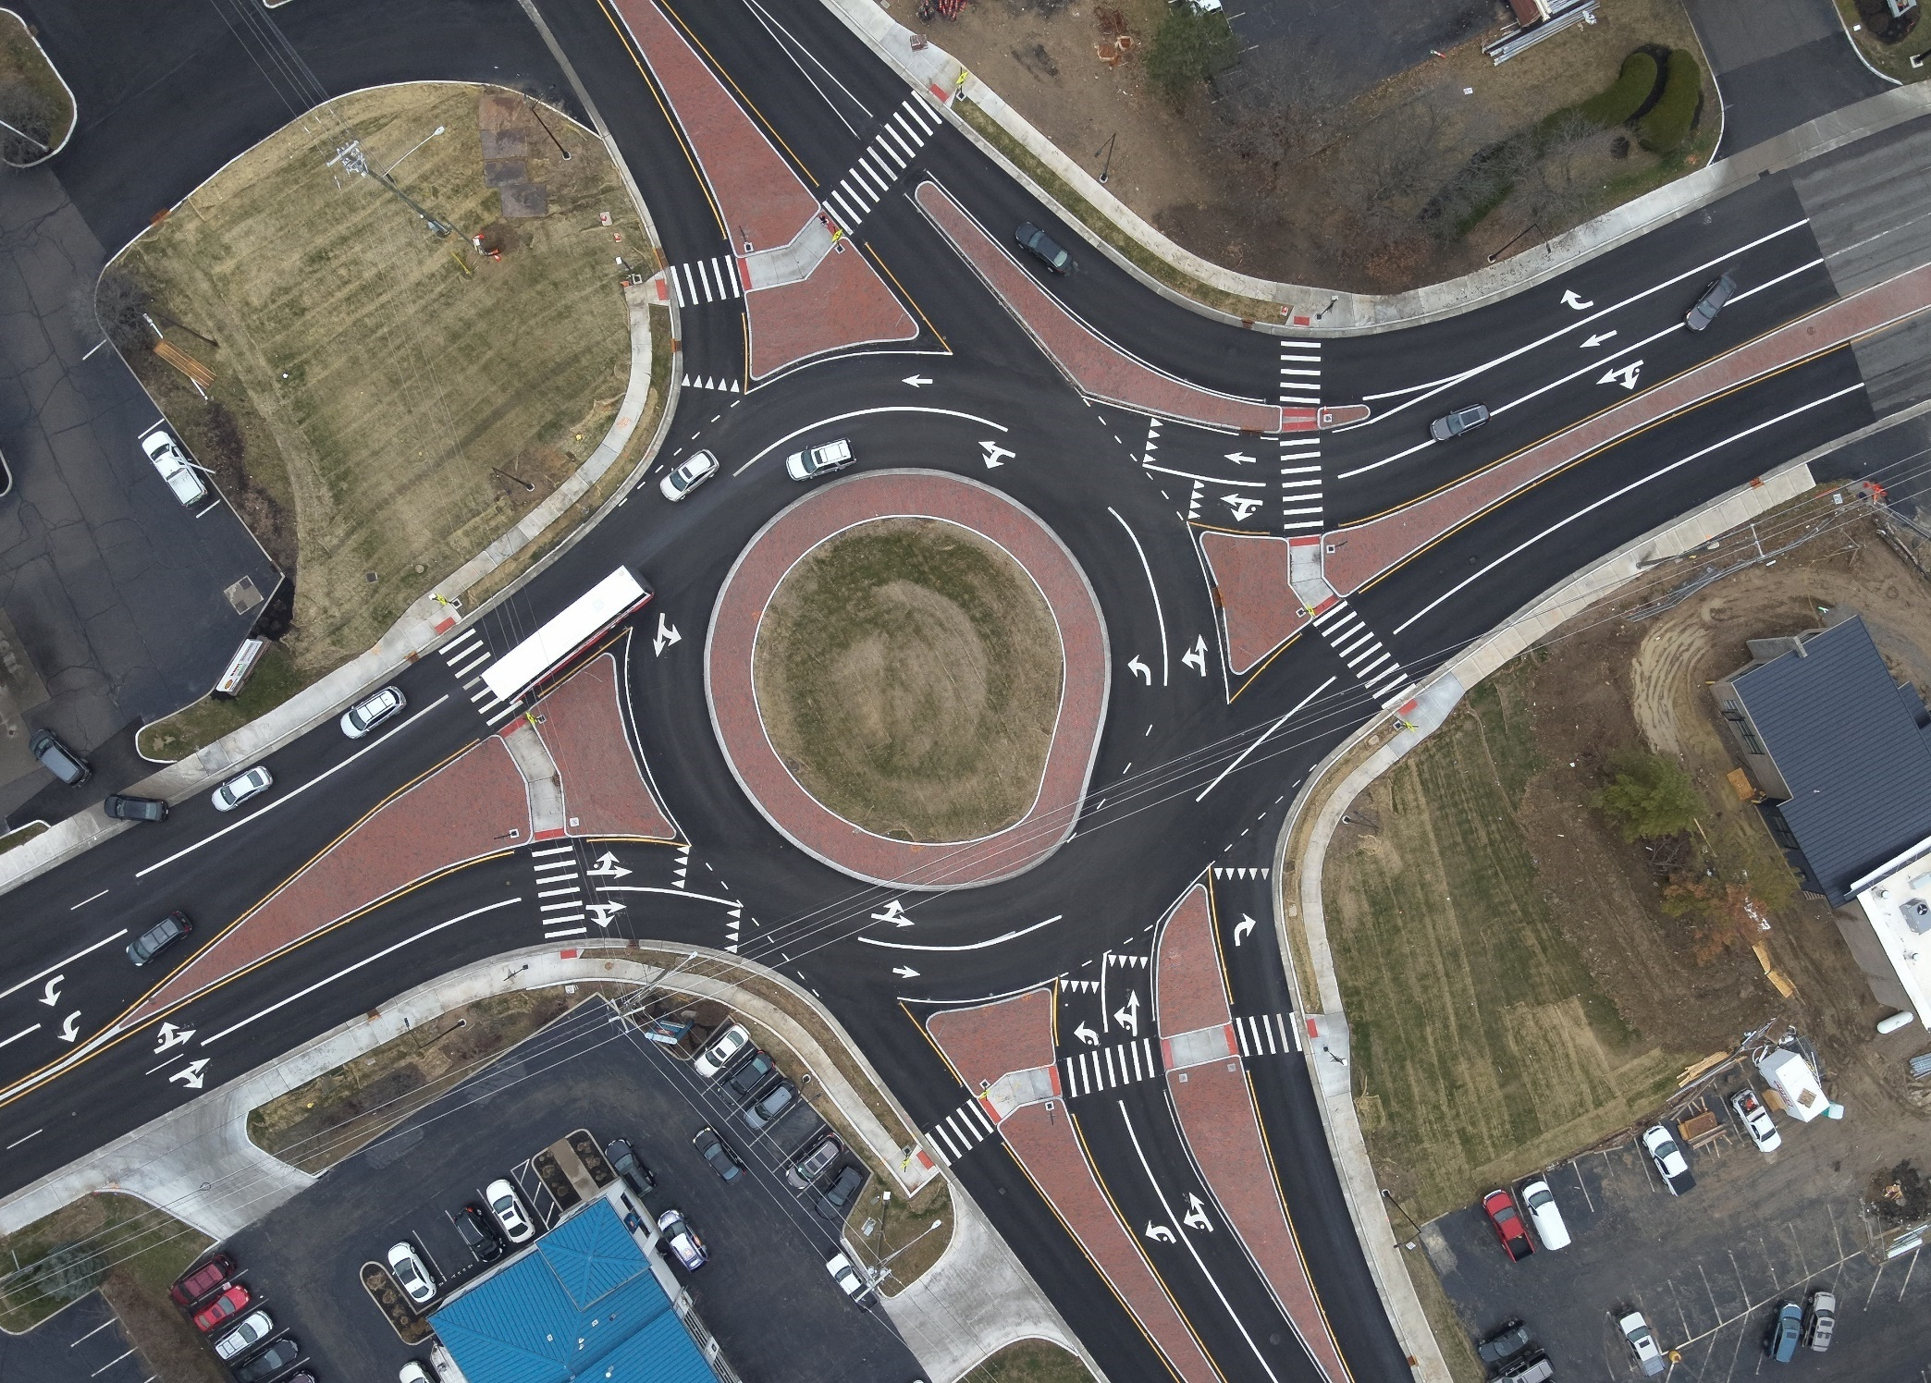
Notes:
This is an overhead drone photo with a similar orientation to rendering.

Slide 17
Early returns
Notes:
What are we seeing so far?

Slide 18
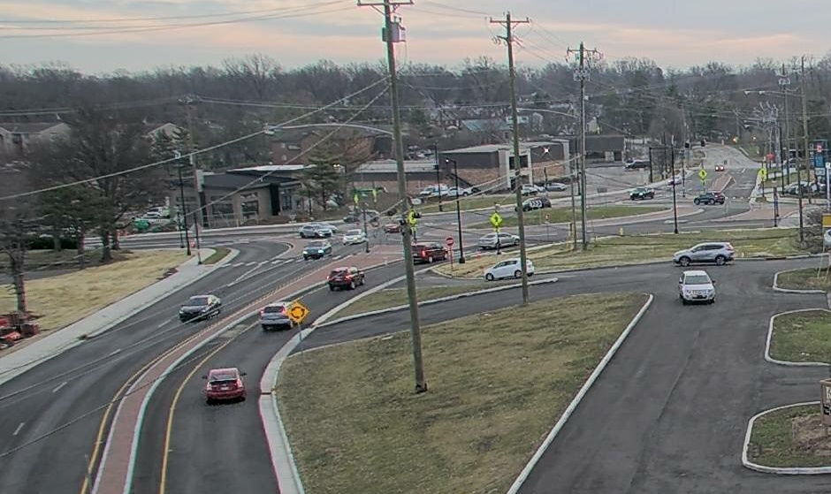
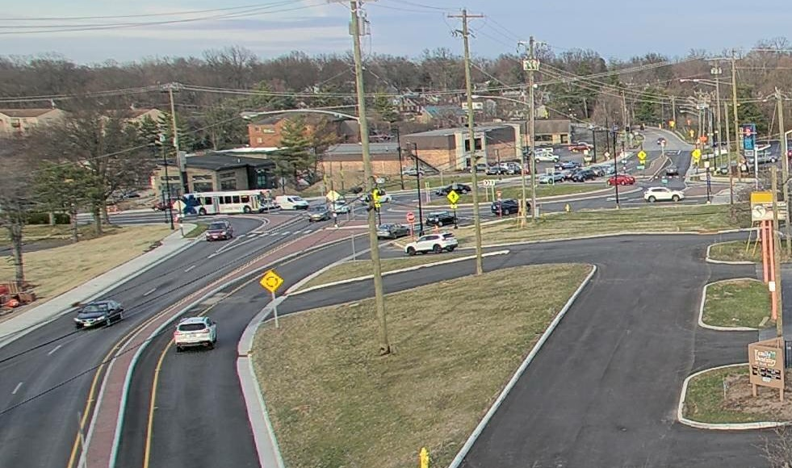
morning peak – Thursday march 2nd, 2023
Notes:
Here is a shot from around 8 am this past Thursday

Slide 19
evening peak – Thursday march 2nd, 2023
Notes:
Here is a shot from 5 pm this past Thursday.

Slide 20
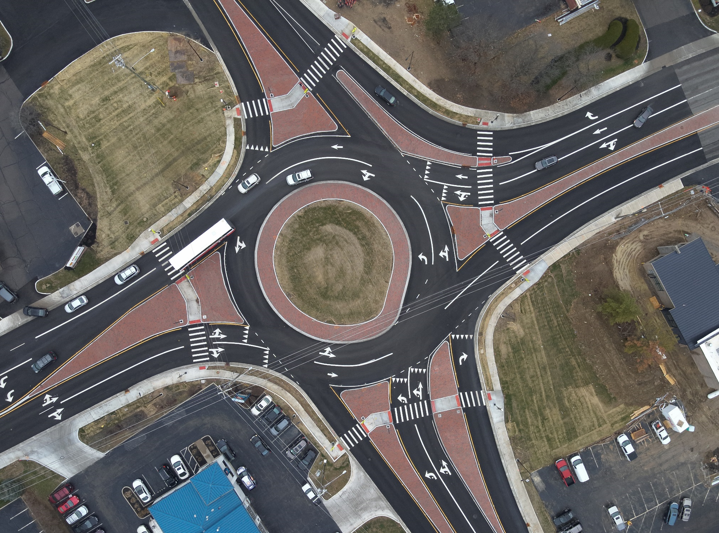
Early returns
Reduced queues
Reduced user delay
Slower, steadier traffic
Zero injury accidents!
Aesthetically improved
Redevelopment
Notes:
Vehicle queues are down. Things are moving steadily. It seems like the traffic calming is working.
The city of Blue Ash will perform a full traffic analysis in the corridor once the 3-roundabout system is constructed after the driver acclimation period.
More comfortable to walk and drive. You aren’t worried about an unexpected aggressive maneuver when the light changes or at a business driveway.
The corridor is also aesthetically improved. The lighting and sidewalks are a definite enhancement. . There are landscape plans for the roundabout center circles.
There are also reinvestments plans for the Kohl’s parcel too. So, Blue Ash is already seeing some economic benefit from their investment.

Slide 21

THANK YOU!
Craig Litmer, PE
Project Manager
513.407.8317
clitmer@structurepoint.com
Notes:
Again, I am Craig Litmer with American Structurepoint. It was very rewarding to see this project come to life, and a prime example of how funding can fix congestion and safety issue. Again, I’d like to thank OKI for being a great partner in navigating the funding process, and the City of Blue Ash for being an insightful, dedicated client to work with.

