Slide 1
The LPA Process
OKI Intermodal Coordinating Committee
Presentation by Dane Blackburn,
KYTC District 6 LPA Coordinator
Cincinnati, Ohio | June 06, 2023

Slide 2
Vision
Striving to be national leaders in transportation who provide transportation infrastructure and services for the 21st century that deliver new economic opportunities for all Kentuckians.
Mission
To provide a safe, efficient, environmentally sound and fiscally responsible transportation system that delivers economic opportunity and enhances the quality of life in Kentucky.
Notes:
Vision
Striving to be national leaders in transportation who provide transportation infrastructure and services for the 21st century that deliver new economic opportunities for all Kentuckians.
Mission
To provide a safe, efficient, environmentally sound and fiscally responsible transportation system that delivers economic opportunity and enhances the quality of life in Kentucky.

Slide 3
Federal Funding Opportunities
Surface Transportation Funds (SNK)
Transportation Alternatives (TA)
Congestion Mitigation & Air Quality (CMAQ)
These programs are not grants, but reimbursement programs
Notes:
There are three main sources of federal funding available for projects in Kentucky: SNK, TA, and CMAQ.
Examples of projects include: sidewalks (upgrading to ADA compliance, providing a safe route from schools or neighborhoods, pharmacies and assisted living facilities), transference of diesel busses to electronic, roundabouts, safe routes for non-drivers, bicycle or pedestrian transportation facilities, traffic flow improvements, etc.
These programs are not grants, but reimbursement programs requiring a minimum of 20% local match.
Projects that are SNK-funded are administered wholly by the District 6 Office.
Projects that are TA- or CMAQ-funded are administered by the Office of Local Programs in Central Office, with assistance from District 6 on approvals for final design, right-of-way, utility coordination, traffic management plan, and encroachment permit.

Slide 4
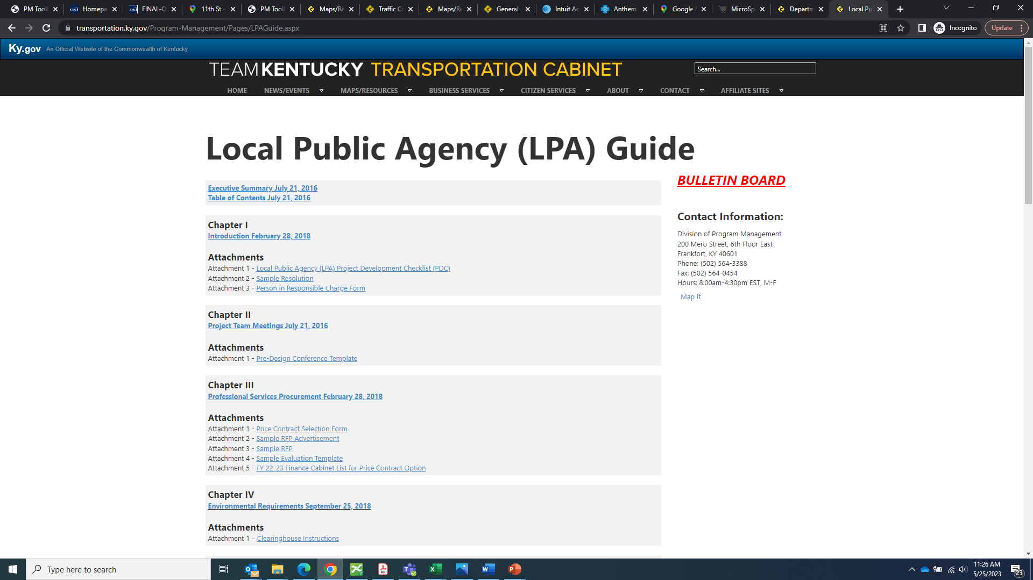
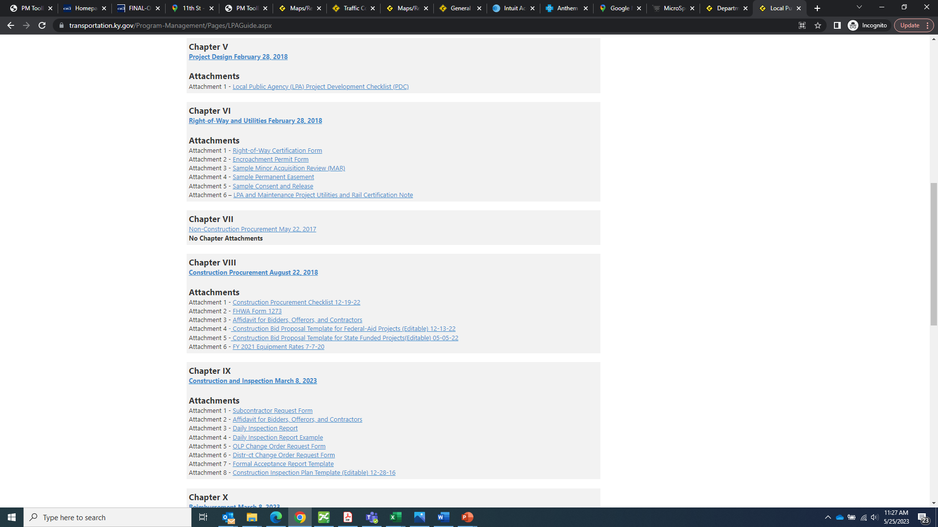
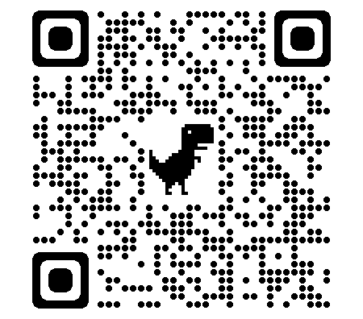
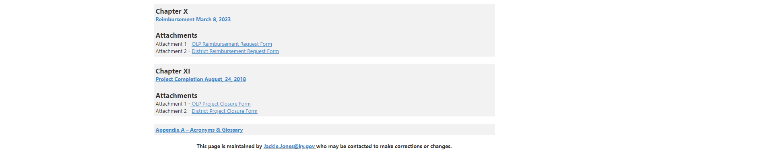
KYTC LPA Guidance Manual
Prior to the commencement of any project, all Local Public Agencies should become familiar with the practices outlined in the KYTC LPA Guidance Manual
Notes:
Prior to the commencement of any project, it is imperative for all Local Public Agencies to become familiar with the LPA Guidance Manual. I cannot emphasize this enough. I recommend saving and keeping handy a copy of the Project Development Checklist in the very first chapter to serve as a guide for all required approvals in order to get your project to construction.
The LPA Guide can be found on KYTC’s website or by googling KYTC LPA Guide. It is the first result that pops up.
It is important to note, no deviation is allowed from this manual; this is the federal process. Another important thing to note is that if any phase is expected to use federal funds, the entire project must follow the federal process. For example, we recently had a project where the LPA hired a consultant and already had a set of plans fairly ready to go to construction and paid for all this using local funds. They then applied for construction funding through OKI, but during the review process, KYTC discovered the LPA did not follow the federal processes for hiring a design consultant or performing the environmental analysis, so we basically had to start the project all over again from scratch.

Slide 5
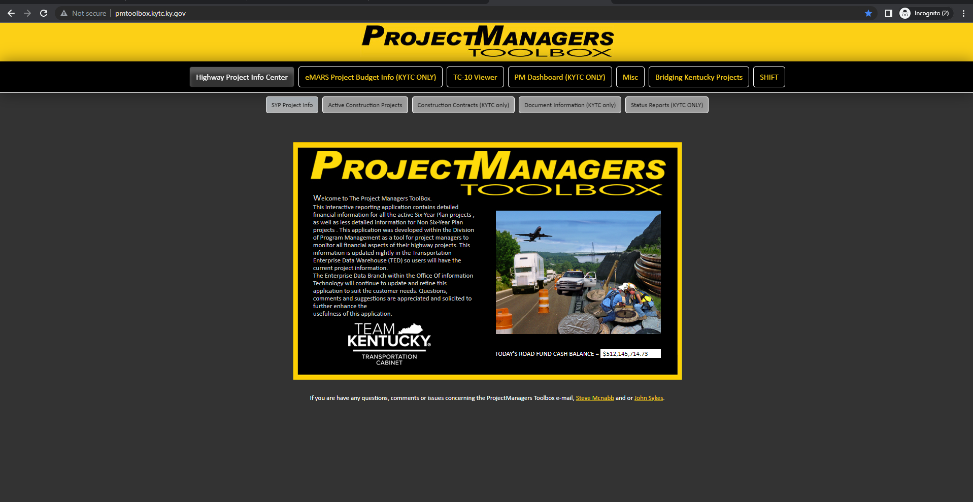
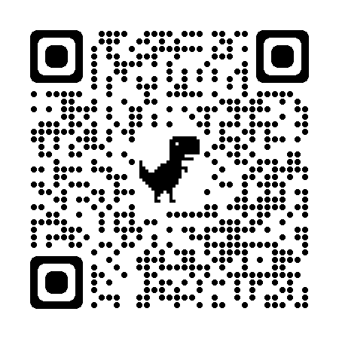
Funding Authorization
Funding authorization and Notice to Proceed must be given prior to the occurrence of any project activities
NTP will be issued for each individual phase (Design, Right-of-Way, Utilities, Construction) after all parties have executed the MOA
www.pmtoolbox.kytc.gov
Notes:
Funding authorization and Notice to Proceed must be given by the administering office prior to the occurrence of any project activities; partaking in any activities on the project prior to funding authorization jeopardizes the federal funding and is not reimbursable. This includes sending out Requests for Proposals. RFPs should be approved by District 6 prior to advertisement.
A Notice to Proceed will be issued by the administering office once the MOA for that phase has been executed by all parties. An MOA is considered executed on the date it is signed by the Secretary of Transportation.
I’ve included a screenshot and QR code to Project Manager’s Toolbox on this slide. Here you are able to find the State project authorization (known as the TC-10) and funding details for your project.

Slide 6
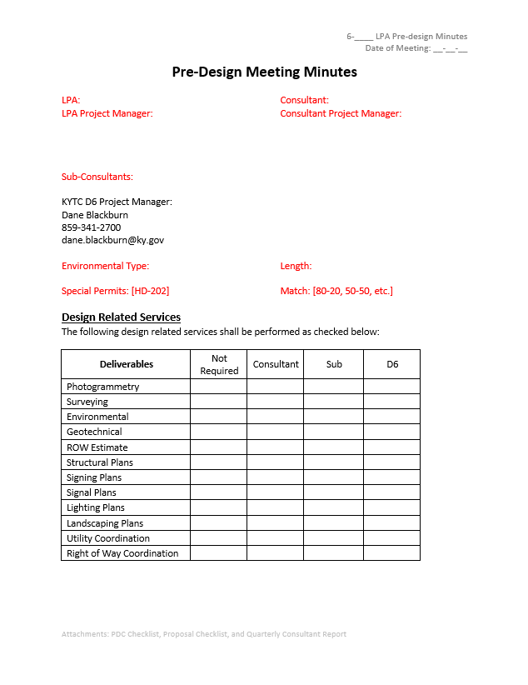
Pre-Design Scoping Meeting
To kick a project off, a Pre-Design Scoping Meeting should be held
After this meeting, production hour negotiations can commence
Once approved by the administering office, a Notice to Proceed with that phase will be issued
Notes:
To kick a project off, a Pre-Design Scoping Meeting should be held. During this meeting, the scope of work will be discussed along with the expectations of each entity, including the LPA, the Consultant, and the State.
After this meeting, production hour negotiations will commence. Once production hours are agreed to by the LPA and the consultant and approved by the administering office, a Notice to Proceed will be issued.

Slide 7
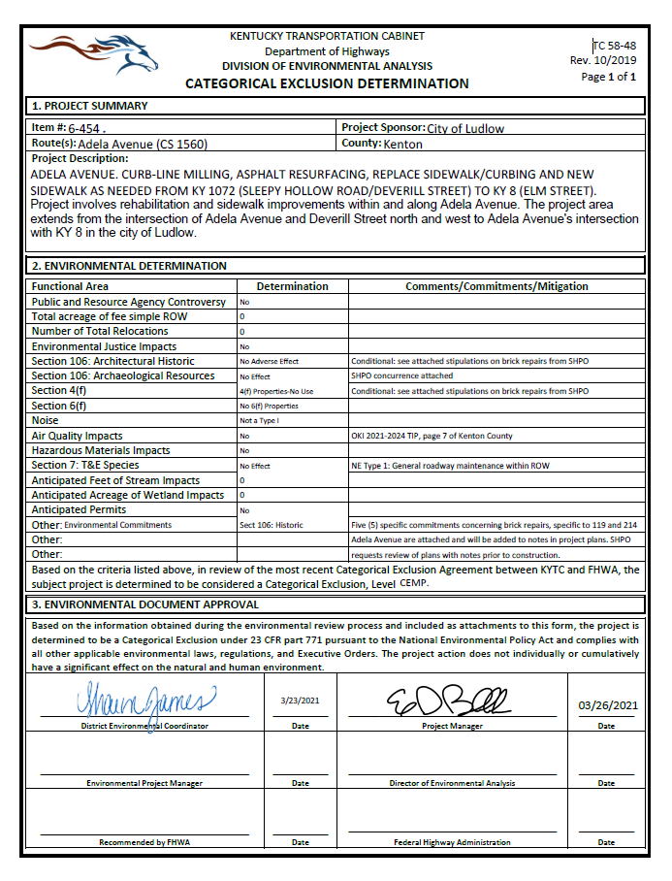
Environmental Overview
Project estimates should include enough funding to cover the cost of hiring an environmental consultant
Options include:
  Utilizing KYTC’s Statewide environmental contracts
  Hiring an environmental subconsultant
Approximate fee: $30,000
Notes:
We, on the Kentucky side, have been running into an issue with staffing and logjams at the Department of Environmental Analysis, mainly in the State Historic Preservation Office. For new projects, we have been advising all LPAs to build enough funding into their project estimates to account for hiring a subconsultant to perform environmental analysis.
This would include two options:
Utilizing KYTC’s statewide contracts for environmental analysis, or
Hiring an environmental subconsultant to perform this task
This is particularly the case in areas with older homes (structures over 50 years old) where cultural and historic impacts can be encountered. In our area, acquiring Right of Way from these types of properties is where the process becomes problematic.
For example, we recently ran into an issue where the LPA is constructing a sidewalk where there currently is no sidewalk. The project evaluated about 50 structures along the corridor and the cost was about $30,000.
Tree clearing restrictions. Typically we can’t remove trees 5” or larger in June and July, and mitigation fees are required for tree removals from April to October.
Sometimes it is necessary to coordinate with and obtain permits from USACE and KY Division of Water if any significant stream and/or wetland impacts are required with the project.

Slide 8
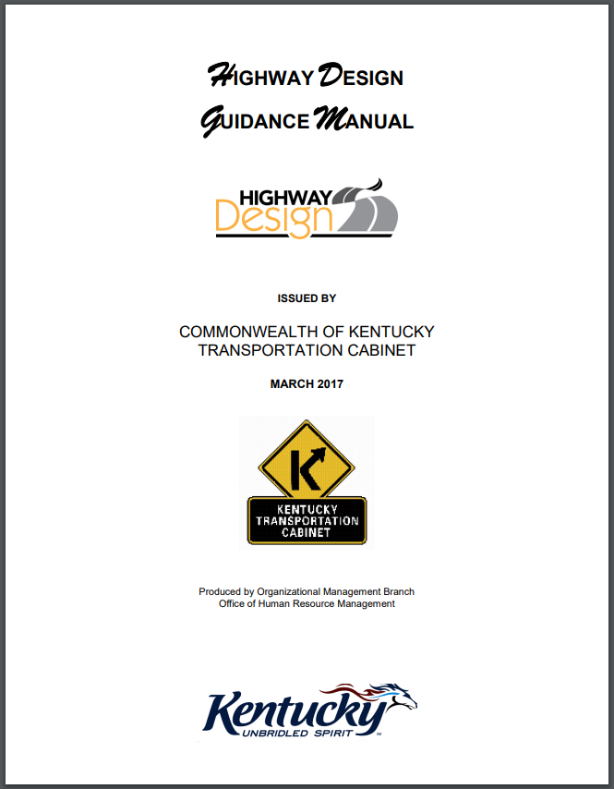
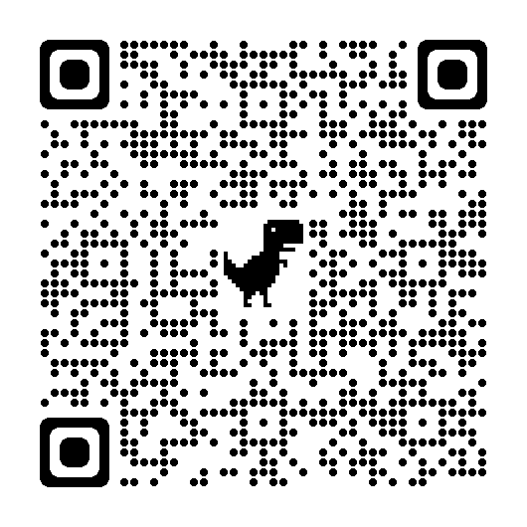
Design Standards
Chapter V of LPA Guide
For roadways and roadside design, the KYTC’s Highway Design Manual (current edition) must be followed
Notes:
For roadways and roadside design, the KYTC’s Highway Design Manual (current edition) must be followed. The main things to consider are the sheet layouts, the format for typical sections, plan sheets, profile sheets, cross sections, line styles, etc.
This helps expedite the review process.

Slide 9
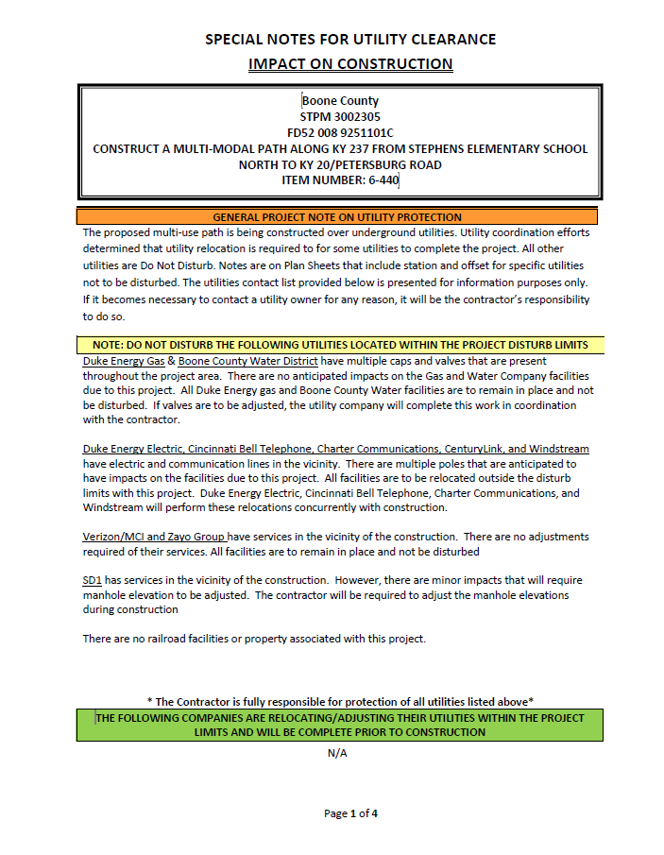
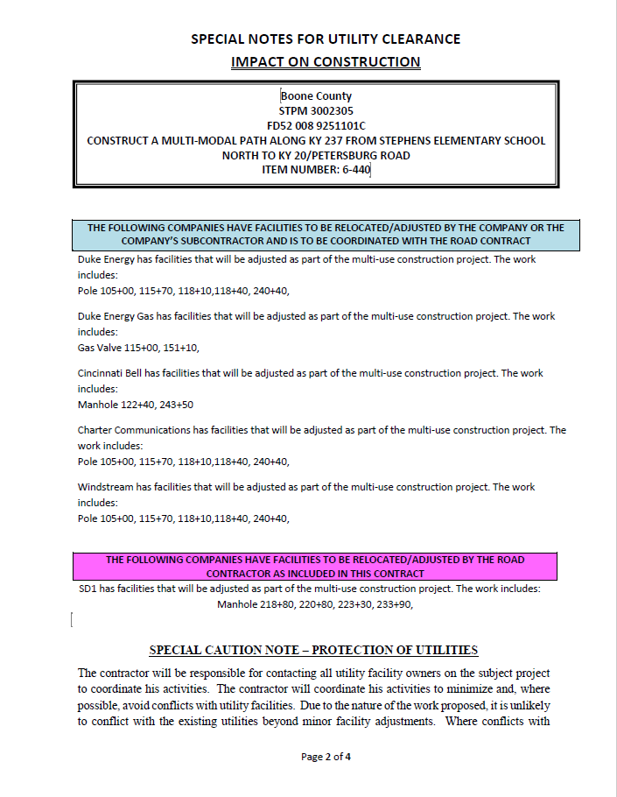
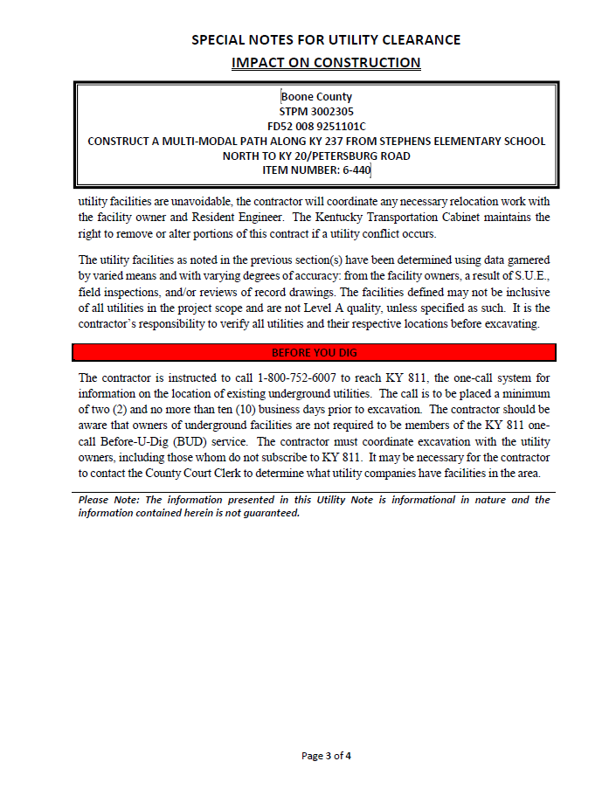
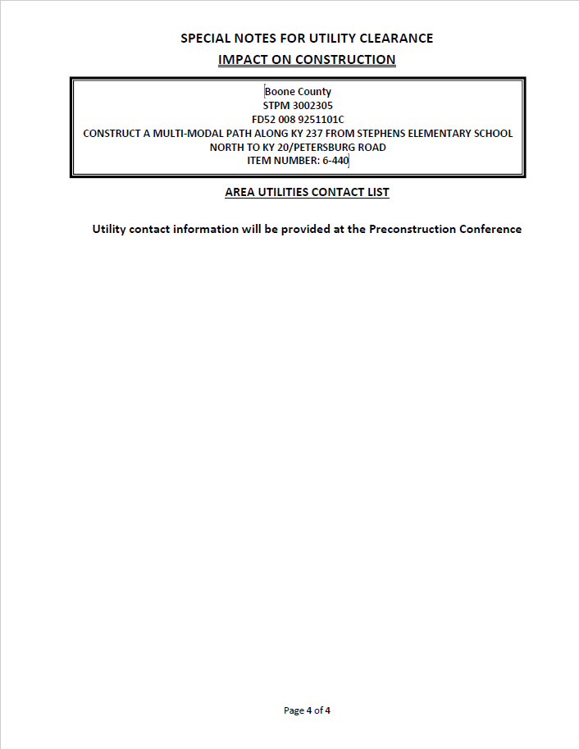
Utility Coordination
Location of all utilities should be shown in plan set
Four categories
  Do not disturb
  Relocation to be complete prior to construction
  Relocation by utility company coordinated with construction
  Relocation by road contractor
Letter of “No Impact”
Notes:
Location of all utilities should be shown in plan set with stations an offsets listed in the Utility Certification for all facilities located within the project limits.
All utility relocations fit into four categories: do not disturb, relocation to be complete by the utility company prior to construction, relocation by the utility company to be coordinated during the construction phase with the roadway contractor, or relocation performed by the roadway contractor.
The District needs to see the communication between the LPA and the utility company showing that the company has been sent a set of project plans and has responded either in concurrence that there will be no impacts to their facilities or with a plan to relocate any affected facilities.

Slide 10
Construction Inspection
Chapter IX
Qualified inspector is required to be on the project’s job site at any time construction work is being completed
Minimum of five (5) years of roadway and/or bridge construction experience
Options include:
  May use design consultant if construction inspection services were listed in the original design RFP
  May advertise for construction inspection services prior to construction
  May utilize KYTC’s statewide rotating list
Notes:
In 2021, FHWA performed a spot review of the LPA construction inspection process. Ultimately, they did not like the way project deliveries and quantity verification were being documented and have enforcing the stipulation that construction inspection is required any time construction activities are occurring. This inspector needs to have a minimum of 5 years of roadway and/or bridge construction experience and must have all of the certifications listed in Chapter 9 of the LPA Guidance Manual.
Several options exist to procure construction inspection services. An LPA may use the design consultant for construction inspection if those services were included in the original RFP. An LPA can advertise for a construction inspection firm prior to construction. Or an LPA may opt to utilize the statewide LPA rotating list of consultants.

Slide 11
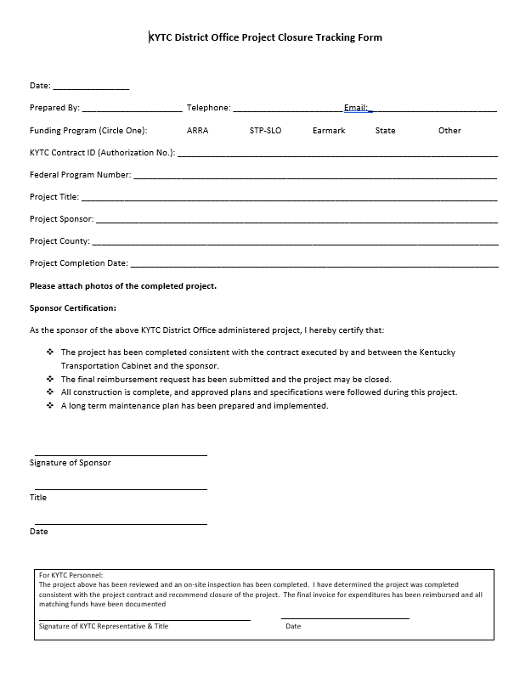
Project Closeout
Once construction is complete, a final walkthrough should be scheduled as soon as possible
A Project Closure Form must be submitted
Final reimbursement for the construction phase cannot occur until the previous two steps have been completed.
Notes:
Once construction is complete, a final walkthrough should be scheduled as soon as possible with the District (and the Office of Local Programs if they are the administering office). This ensures everything was constructed according to the specifications that were laid out in the construction proposal.
After the final walkthrough, a Project Closure Form must be filled out and submitted to the District Office. On this slide, I’ve included a copy of that form.
Final reimbursement for the construction phase cannot occur until the previous two steps have been completed.

Slide 12
Final Thoughts
Ways to keep a project on schedule
  Become familiar with the KYTC LPA Guidance Manual
  Submit plans following KYTC Design Manual
  Depending on scope of project, an environmental consulting firm may be necessary
  Contact utility companies as soon as possible
  Completely and correctly fill in all documents submitted to administering office
Notes:
Ways to speed up the review process:
LPAs should become familiar with the LPA Guidance Manual
Submit plans following the KYTC Design Manual
In coordination with KYTC, decide if an environmental consultant is necessary for the project. Be sure to include these services in the design RFP.
Completely and correctly fill in all documents submitted to administering office (including Right-of-Way Certification, Utility Certification, Traffic Management Plan, Encroachment Permit Application, reimbursement requests, etc.). All Federal and state project numbers that need to be filled in on various forms can be found in the agreement and/or the funding authorization that you receive at the outset of the project. If you ever need help filling out a form, we are happy to help and can provide examples from other projects. Let us know as soon as possible that you are having trouble filling out a form rather than submitting an incomplete form.
As I stated earlier, these are the most common issues we run into with LPA projects. Following the process laid out in the LPA Guidance Manual helps speed up the review process. This in turn helps keep your projects on schedule and helps ensure timely reimbursement to the LPA. We are always available to help with questions or concerns that arise along the way.

Slide 13
QUESTIONS?
Dane Blackburn
LPA Coordinator
District 6 Planning
421 Buttermilk Pike
Covington, Kentucky 41017
(859) 341-2700 OFFICE
dane.blackburn@ky.gov

